Slide 1
Ph.D. Studies for MSCIS Graduates
The MOU Between AU and
University of Oviedo
Dr. Qing TAN
FST Graduate Students Orientation Nov. 5, 2019

Slide 2
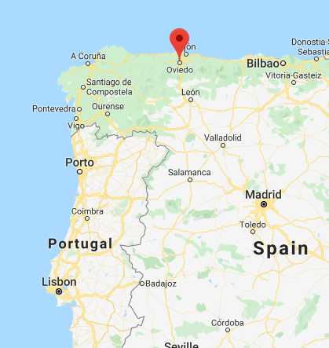
University of Oviedo
Oviedo, Spain
Since 1608

Slide 3
Figure and Facts
25.000 Students
2.000 Lecturers and Researchers
1.000 Administrative Staff members
57 Undergraduate Degree programmes
50 Master's Degree programmes
6 Erasmus Mundus Master's programmes (3 coordinated by the University of Oviedo)
24 PhD Programmes
65 Certificate Courses
210 Beds in university halls of residence
800 International students
17 Faculties and Schools, 38 Departments
€198 million annual budget

Slide 4
Computer Science Department
Knowledge areas:
Computing Sciences and Artificial Intelligence
Languages and computing systems
Architecture and Technology of Computers
Information Technologies
More tan 125 members, mainly in the two first knowledge areas.
Teaching mainly in Computer Science, in all the engineering degrees and in Mathematics degree.

Slide 5
PhD Program in Computer Science
The basic goal of the PhD Programme in Computer Science of the University of Oviedo is to provide formation to PhD candidates in technologies, applications, services and contents of the Society of Information, promoting the advance of knowledge, the development and innovation in information technologies and in the technologies used to create digital contents and the services related to them, through scientific research and excellent technological development.
Degree + Master in CS
Need to legalize them
Other degrees can also be accepted (Engineering Degrees, Physics and Mathematics). In these cases, the Master must be focused on research.
Criteria of admission:
Average grade of the academic record.
Curriculum Vitae.
Relation via a Grant or Contract with the University of Oviedo.
Knowledge of languages.
Check on http://www.uniovi.es/en/-/programa-de-doctorado-en-informatica

Slide 6
The MOU – the Universities
Build a bridge for AU’s Master of Science in Information Systems (MScIS) program graduates to apply and enrol into the PhD program at the University of Oviedo
Joint applications for international projects and funding;
Interchange or participation of staff from each institution for research and discussions;
Exchange and joint training of graduate students from each institution;
Other activities which may be organized from time to time, and which may be agreed as being of mutual benefit.

Slide 7
The MOU – the MScIS Graduates
Application Requirements
A faculty member from AU designated as a co-supervisor for their PhD study;
A research proposal has to be developed jointly with a faculty member of AU;
A letter of consent from a faculty member of AU;
An official transcript from AU.
Key Facts
The Quota: 2 – 5 students per year
Application Deadline: June 30 every year
4 – 5 years part-time distance learning;
Two mandatory research methodology course;
At least one quality publication per year;
Pay the fees for the whole program in total less than € 1300 Euros (2018).

Slide 8
The MOU – The PhD Students
Msc. Mortez Kiadi (2018 – Present)
Topic: Machine Learning algorithms to balance Fog and Cloud computing for optimizing the Cyber-Physical Systems performance
Co-Supervision: Drs. Jose R. Villar, Qing Tan
Msc. Behzad Karim (2018 – Present)
Topic: Cloud Robotics for Navigating Telepresence Robots in Smart Labs
Co-Supervision: Drs. Juan C. Alvarez, Qing Tan
Msc. Frederick Ako-Nai (2019 – Present)
Topic: A Blockchain Based Online Learning Content Creation and Management Framework
Co-Supervision: Drs. Enrique de la Cal Marin, Qing Tan

Slide 9
The MOU – The Coordinators
Dr. Qing Tan – Athabasca University
qingt@athabascau.ca
Dr. Jose R. Villar – University of Oviedo
villarjose@uniovi.es

Slide 10
Question?

