Slide 1
FST AU Library orientation
2
+
2
+
November 9, 2020
Joanna Nemeth, Instruction & Reference Librarian
Notes:
Hello everyone! Welcome to this introduction to AU Library’s resources and services.

Slide 2
Agenda
2
+
Library Basics
AU Library Homepage
Searching
AU Business Databases
Citation Management Tools
Getting Research Help
Questions
Notes:
Here’s what we’ll cover this morning. I’ll show you the basics of using the Library, and will show you how to navigate the AU Library homepage, I’ll show you how to search the Library’s collections, including searching within a Business-related database. I’ll briefly touch on citation management tools, and then will show you where to go for research help.

Slide 3
Library Basics
2
+
2
+
Notes:
Let’s begin with the basics.

Slide 4
Terminology: AU Library Catalogue
2
+
Where you can search for…
Books:
Print (150,000+)
Ebooks (300,000+)
Video:
DVD
Online streaming
Notes:
I’m sure most of you are familiar with this stuff already, but it’s always a good idea to do a bit of a refresher. A library catalogue is where you can search for print books, e-books, videos, CDs etc. In the AU Library catalogue, you can find all of these resources, plus resources that are used in specific courses. Our library catalogue contains over 150,000 print books and over 300,000 e-books, as well as other items.

Slide 5
Terminology: periodicals
2
+
Journal articles
Journals
Databases
Notes:
I am now going to briefly describe periodical publications; specifically, journal articles, journals, and journal databases.

Slide 6
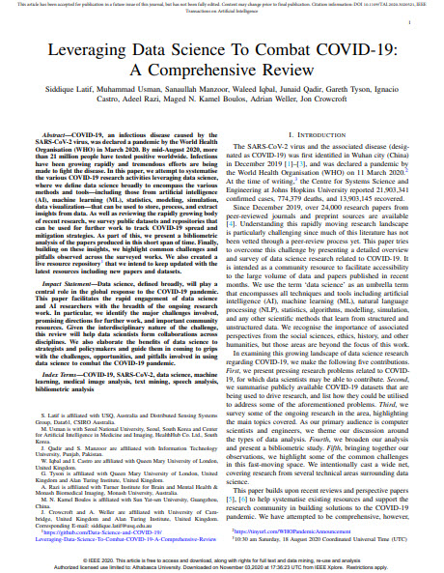
Journal article
Notes:
As you work on assignments for your classes, you may be asked to find journal articles to support your argument. A journal article is usually written by a scholar or expert in a field and the audience for these articles is usually faculty, researchers or scholars. Journal articles are usually considered to be scholarly, as opposed to articles published in magazines.
Here is an example of one journal article

Slide 7
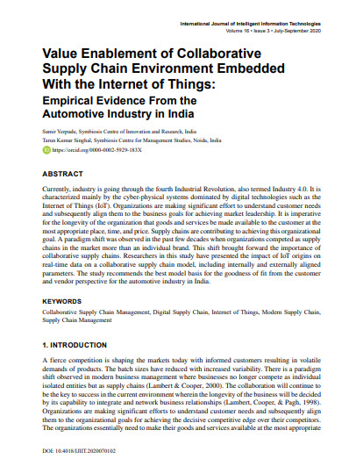
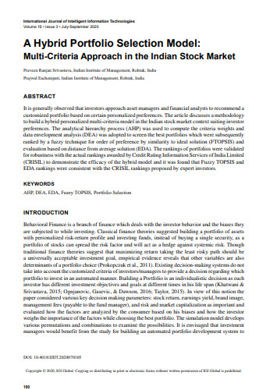
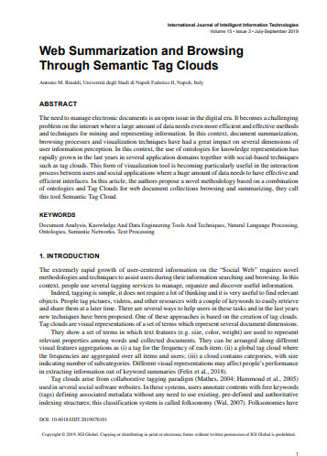
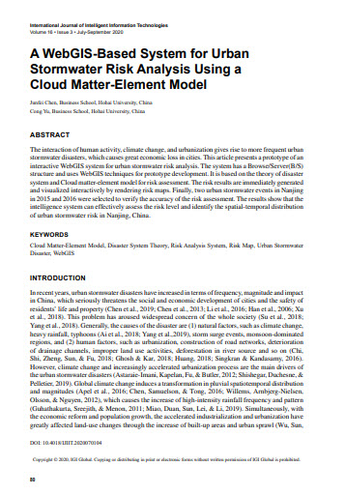
Journal
Notes:
Several different journal articles are published in a single journal, as you can see here
Journals are a type of publication that are published periodically, and are sometimes referred to as periodicals, scholarly journals, refereed journals, or peer reviewed journals.
If a journal is described as peer reviewed, it means that experts in the field have reviewed each of the articles found within it before they were accepted for publication.
Journals may be published with a variety of frequencies: once a year, twice a year, every quarter, every two months, etc.

Slide 8
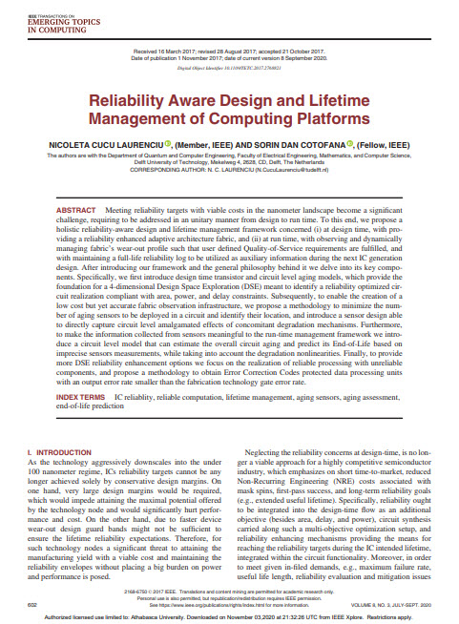
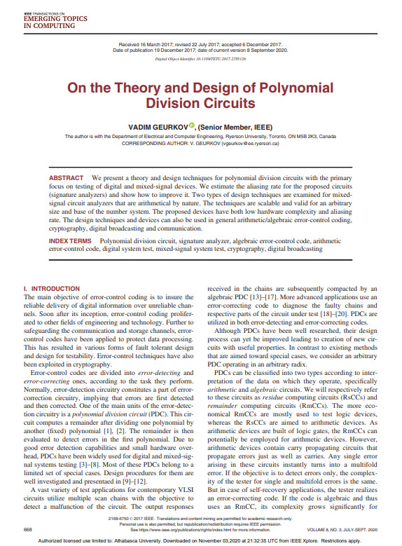
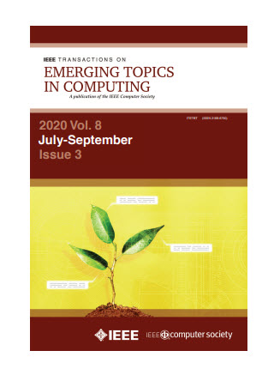
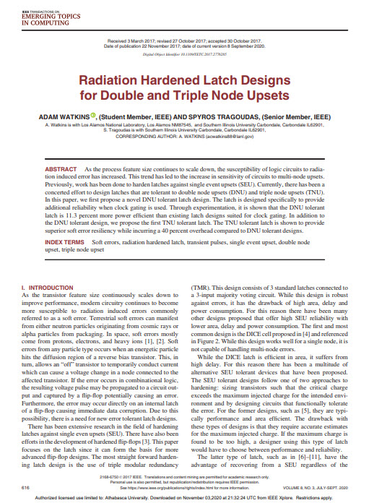
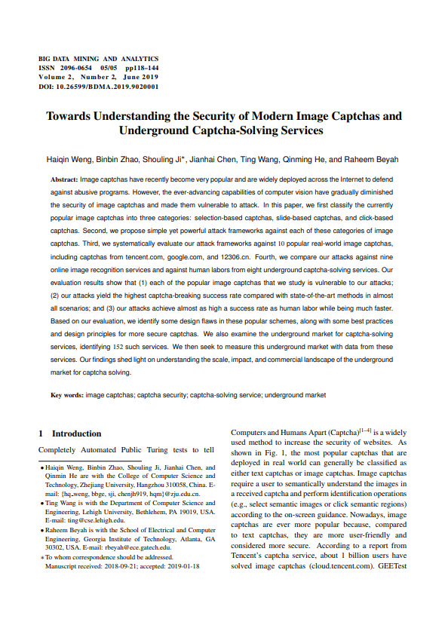
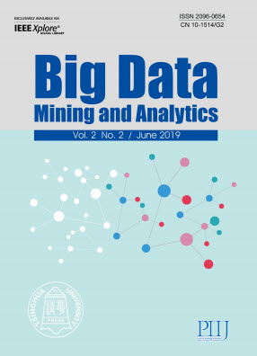
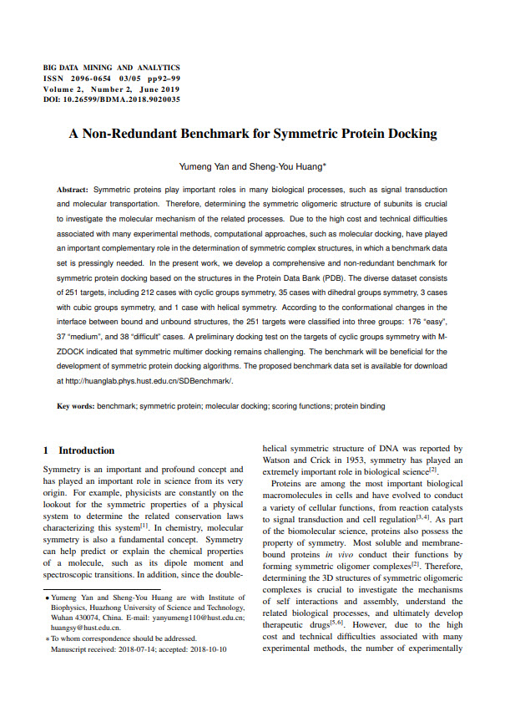
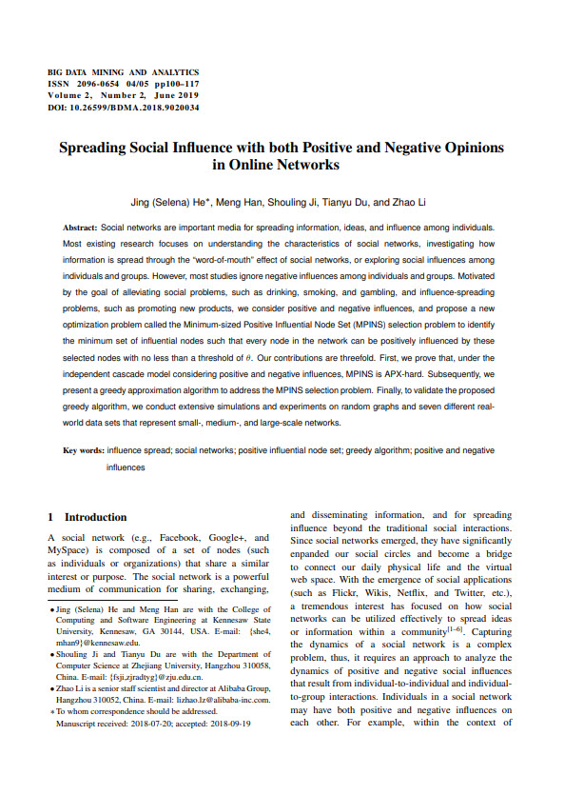
Notes:
Several different journals will be gathered into a journal database, or periodical database. Some journal databases include the full text of articles, while others only provide the citations and abstracts for the journal articles found within it. Journal databases may also include articles from magazines, and other sources, but most also provide you with the option to limit your search to journals that are scholarly or peer reviewed.

Slide 9
AU Library has…
2
+
200+ databases
107,000+ journals
Millions of articles
Notes:
Through AU Library you have access to over 200 journal databases, and more than 107,000 individual journals in full text.

Slide 10
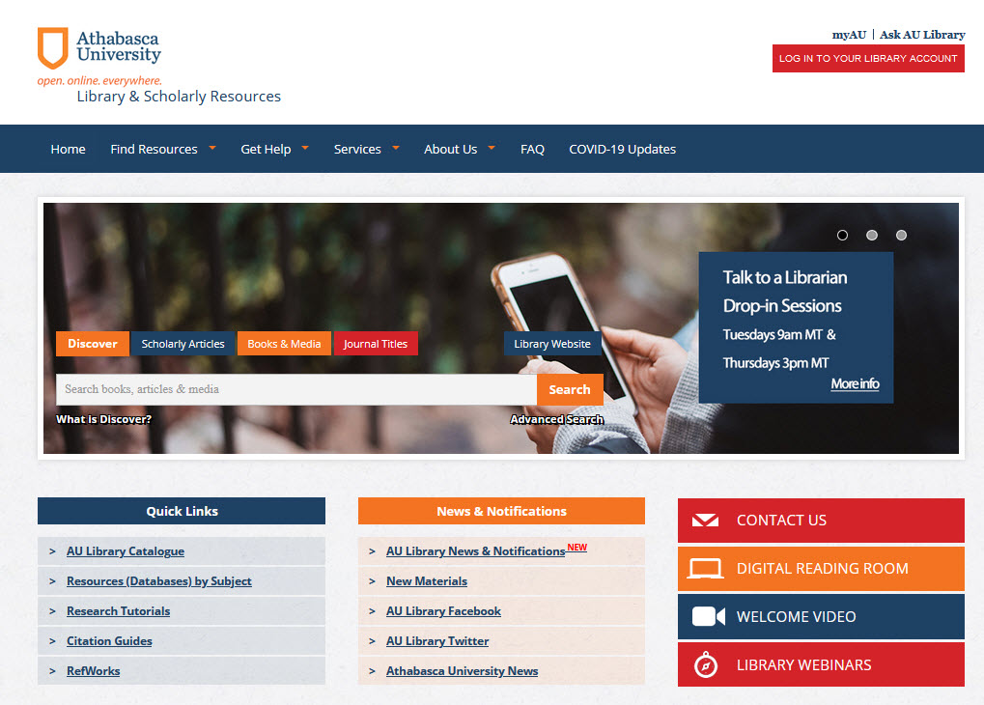
Notes:
From the Library’s homepage, which you can find at library.athabascau.ca, I will show you how to navigate the site, and where to find some important items.

Slide 11
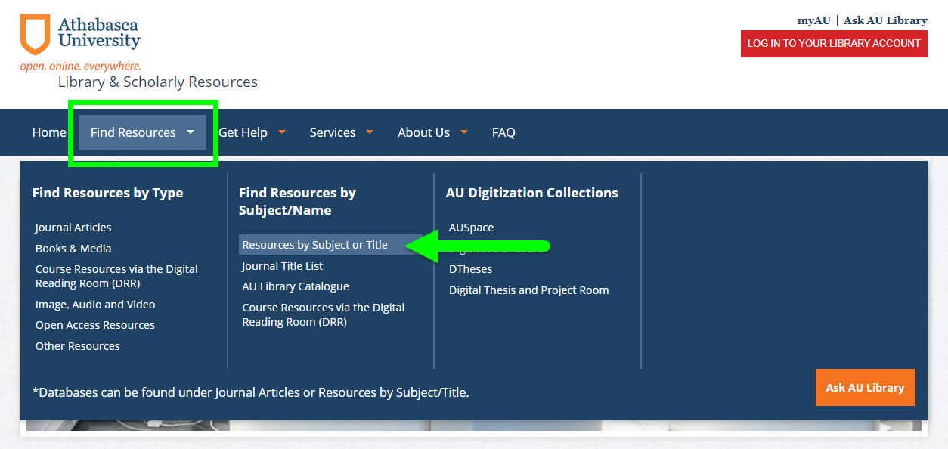
Notes:
Under “Find Resources by Subject or Title”, you can find all of our databases. More on this later.

Slide 12
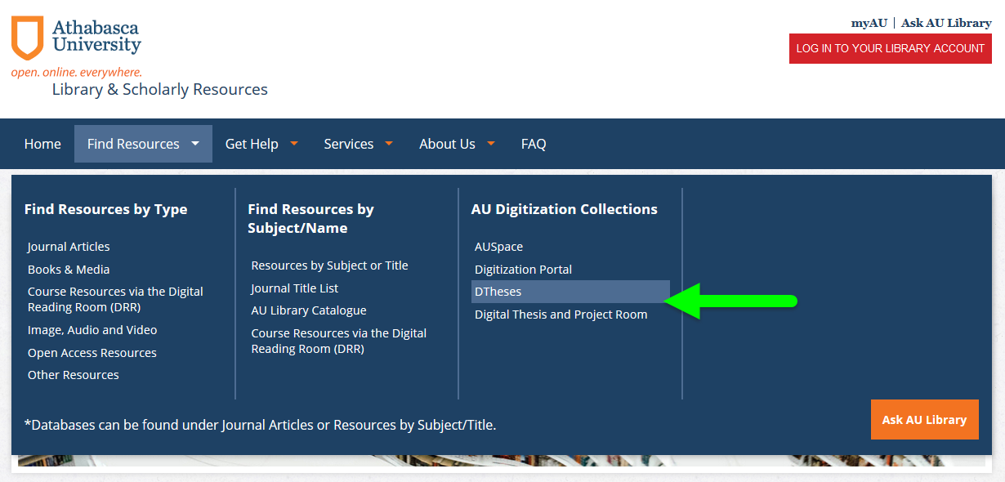
Notes:
You can find Theses and Dissertations from former AU students in the DTheses and Digital Thesis and Project Room collections.

Slide 13
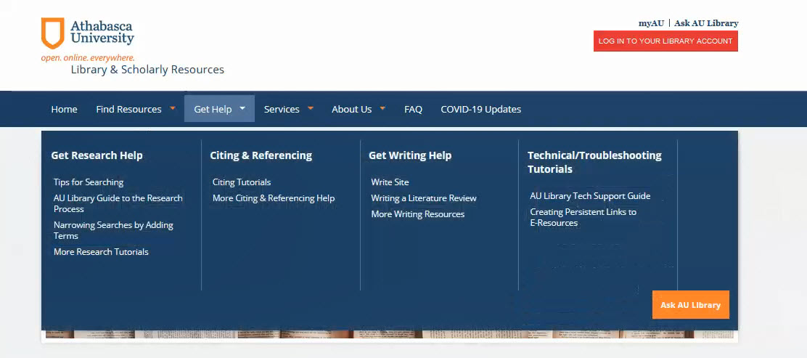
Notes:
Get Help is a very useful tab, as we offer lots of help guides, and links to support within the library and across campus. Library tutorials are listed under “Get Research Help”.

Slide 14
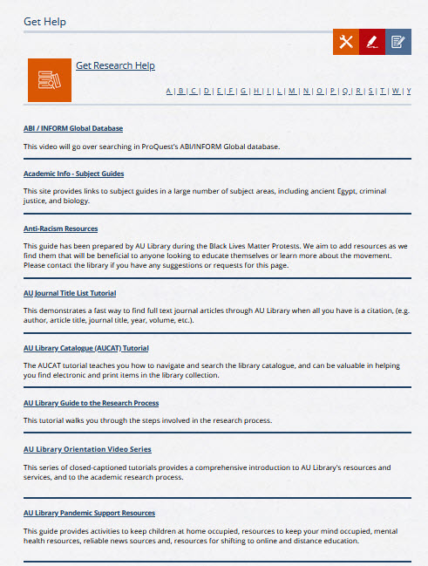
Notes:
These tutorials are in a variety of formats, and cover topics from creating effective search strategies and the research process to using specific resources such as the Journal Title list and the Library catalogue. You can also find help with citation styles and writing from the Get Help page.

Slide 15
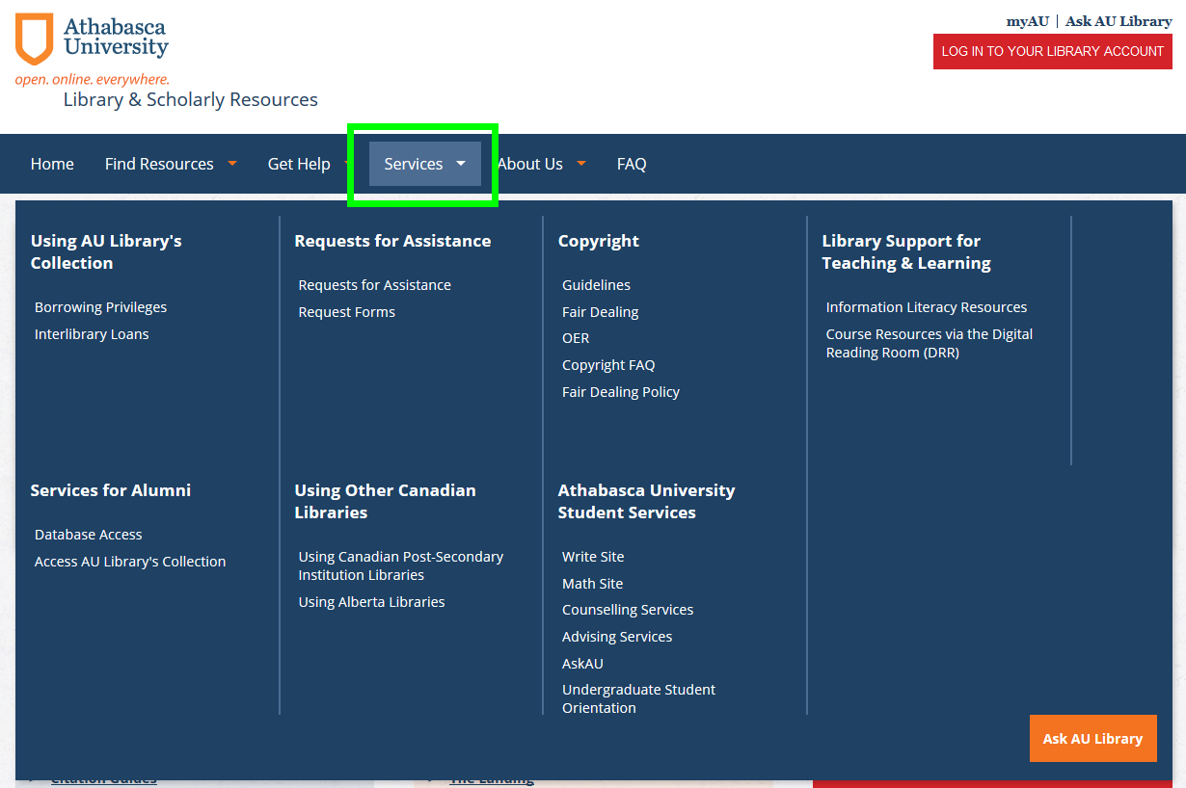
Notes:
The Services tab is where you will go to find out about the services offered through the library and selected services from elsewhere in the university.

Slide 16
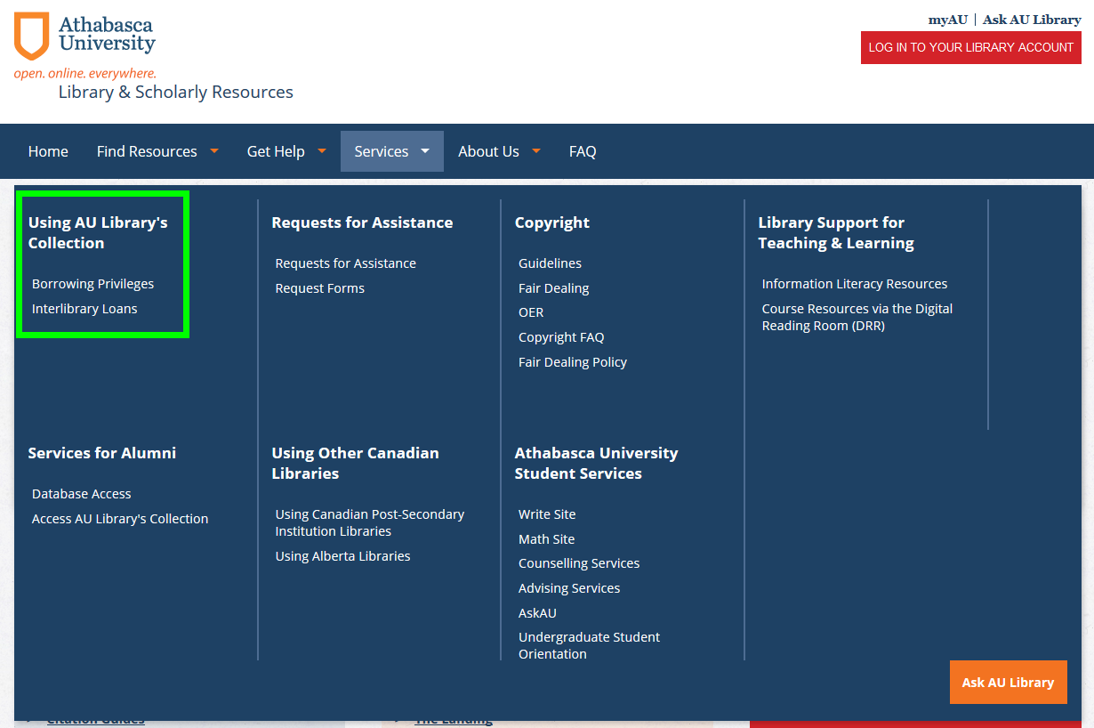
Notes:
“Using AU Library’s Collection” outlines our borrowing policies. Your MyAU login grants you free access to our licensed resources, such as journal databases and e-books. You can also request items from our physical collection, and we will send them to you for free. If you reside in Canada we will also include a prepaid return postage label. Students who reside outside Canada will need to pay the return postage. Interlibrary loans are offered to students for item that can be copied, such as journal articles or a book chapters. We cannot to interlibrary loans for books.

Slide 17
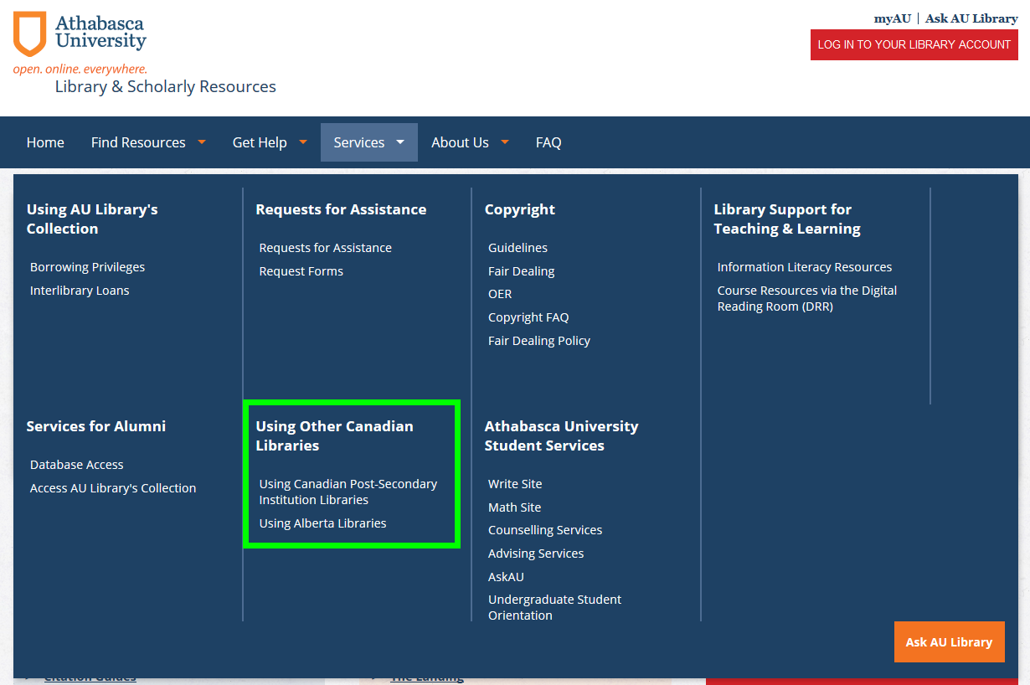
Notes:
“Using Other Canadian Libraries” offers information for finding items the Library doesn’t have.
If you are seeking something that the Library does not own, we will work with you to see if there is a library close to you that may have it. We have reciprocal borrowing agreements with select academic libraries across Canada. Within Alberta, we have the Alberta Library card, which allows you to borrow materials from public, post-secondary and government libraries in this province. For students outside Canada we can write a letter of introduction which may be of help to apply for a library card to an academic library in your country.
If all that is unsuccessful, then you may place an interlibrary loan request for an item that can be copied, such as a journal article or a book chapter.

Slide 18
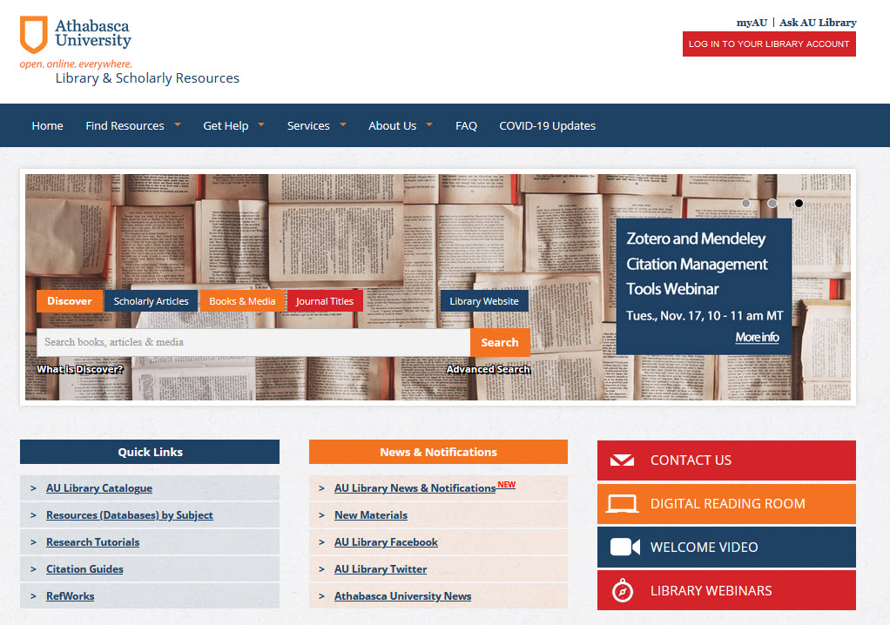
Notes:
Directly below the search box, you will find a set of Popular Links, and News and Notifications. These are both pretty self-explanatory, and the news items and notification items change periodically.
You will find a link to our Face-book page under “News and Notifications”. We encourage you to like our page on Facebook, as this is the easiest way for you to catch the latest library news and announcements, view updates to our webinar schedule, and learn more about our services and resources. We’ll soon be adding a link to our Twitter page here as well.
Contact Us is where you find the Library’s contact information, including our email address, postal address, and phone and fax numbers.
The Digital Reading Room is where you may find course specific materials, gathered in one spot by your professor.
Our Library Webinars page is where you will find the schedule of future webinars, as well as a selection of archived recordings of past webinars.

Slide 19
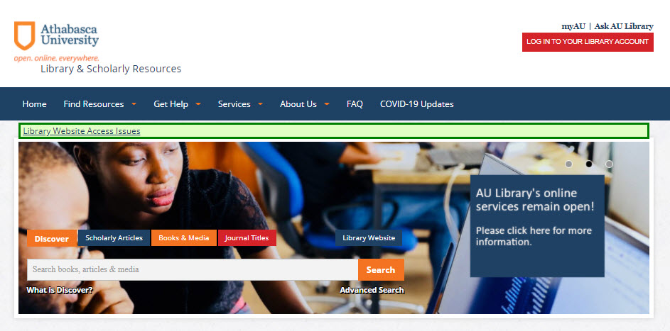
Notes:
In the top-right of the homepage you can log into your Library account. This is the same login that you use for MyAU and to log in to your courses. Once logged in you can request loanable items, see what you have signed out, and renew items you have already signed out, as long as no one has requested it. Just be aware that the login button is static; once you are logged in the button still looks the same so it may appear as though you are not logged in even though you are.

Slide 20
Notes:
In the top-right of the homepage you can log into your Library account. This is the same login that you use for MyAU and to log in to your courses. Once logged in you can request loanable items, see what you have signed out, and renew items you have already signed out, as long as no one has requested it. Just be aware that the login button is static; once you are logged in the button still looks the same so it may appear as though you are not logged in even though you are.

Slide 21
Notes:
Let’s go back to the search box in the centre of the homepage. Across the top of the search box you will see a number of tabs: Discover, Scholarly Articles, Books & Media, Journal Titles, and then at the end, the Library website. Let’s start with Discover. Discover is a sort of meta search tool, or if you like a “mega” search tool. When you conduct a search in Discover you are searching a large subset of the Library’s journal databases, plus the Library catalogue. This can be a really helpful search tool, and is very useful, but because it searches a huge number of resources, it also can result in a very large number of results being retrieved. We’re going to return to Discover later in the presentation so I can demonstrate in more detail how it works.

Slide 22
Notes:
The Scholarly Articles tab is also a type of Discover search, but it is limited to articles that have been tagged as “scholarly”. A search using this tab also eliminates any records that are in the Library catalogue. Again, more on this later.

Slide 23
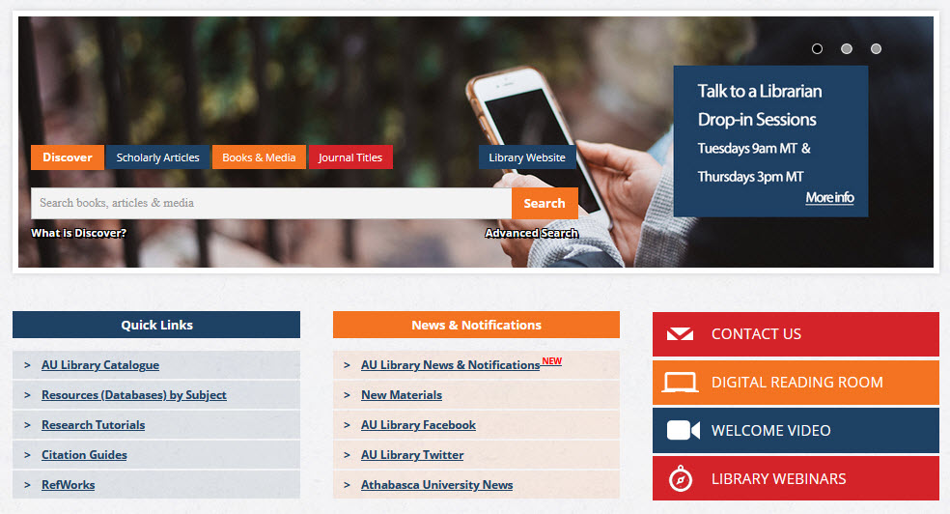
Notes:
If you click on the Books & Media tab and conduct a search there, you are searching the Library catalogue. There are two different interfaces for the Library catalogue, the one listed as Books & Media, and the second found lower on the page in the Popular Links box, called “AU Library Catalogue”. The books and media tab is more like conducting a Google search, in that it’s a keyword search.

Slide 24
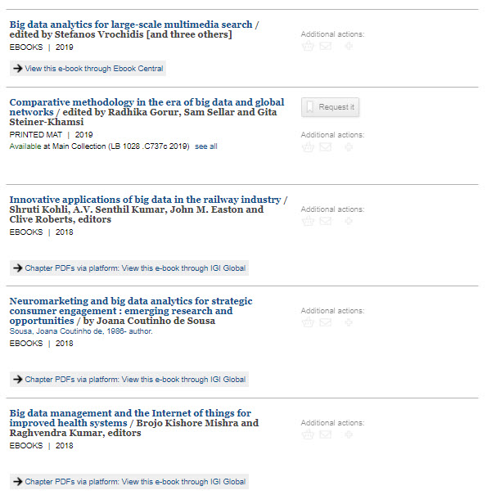
Notes:
The format of each item is indicated below the title. E-books will include a link to view it through one of our e-book databases. When you click that link, you will be taken directly to the e-book. Just a note on e-books. We get our e-books from different vendors, and so your means of access to them can vary. Typically, you will read the book online on your computer or device screen, though some e-books - or parts of them - can be downloaded and saved onto your computer for a short time (usually a few weeks). To order a print book, click on the request it button. When Library staff receives your request, we will send the book to you in the mail.

Slide 25
Notes:
The Journal Titles search is an extremely useful search tool. It is likely that as you progress through your studies, you will be sharing citations for journal articles amongst yourselves and with your course professors. In addition, as you do research, you will sometimes need to find out where the full text of an article can be found. While sometimes you will be given a link to the specific article, often you will only have the citation. The journal title list can tell you where full text can be found in AU Library’s resources. It’s a full listing of all of the journals that AU Library subscribes to in full text. I’ll demonstrate this in more detail later.

Slide 26
Notes:
Thanks Joanna, so remember, Discover searches most, but not all, of our databases as well as the Library catalogue.

Slide 27
Notes:
We offer an in-depth webinar on Discover searching with you may find helpful to view, or you can view our previously-recorded webinar on this topic. You can find this on the Library webinars page.

Slide 28
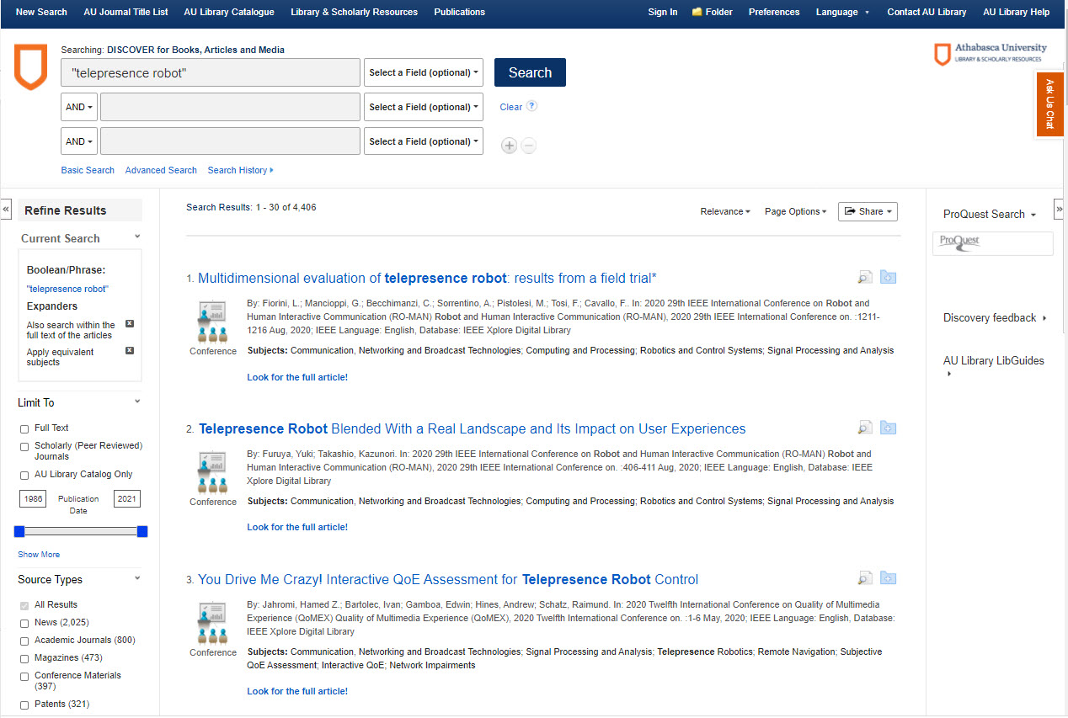
Notes:
As you can see, this search has generated over 400,000 results. The records in the results list will include books, e-books and videos from the Library, as well as journal articles and other items. This is a very general search example, and normally when you are searching for materials you should use a more specific search strategy, instead of just searching for one or two terms. I will show you how to create a better search in a minute, but before I do so, will show you some of the limiters that are available to you in Discover.

Slide 29
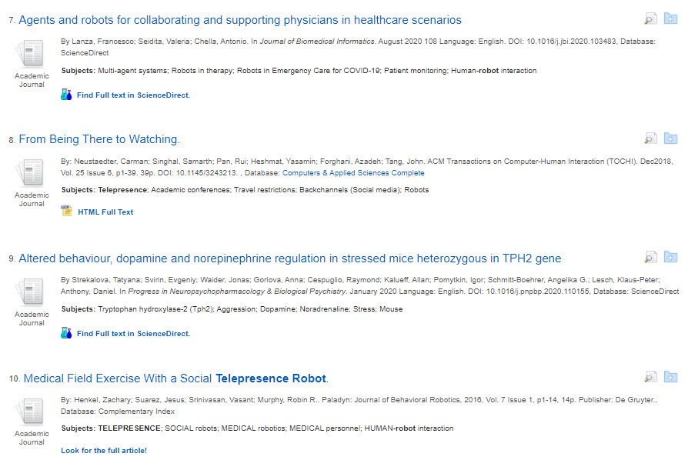
Notes:
Next, I will show you how to find articles that may not be available in full-text in Discover. For example, record #22 does not have a.pdf attached to the record, as others do. This is because this item has been indexed by Discover, but the full text is not available directly from Discover. However, it may be available in another database.

Slide 30
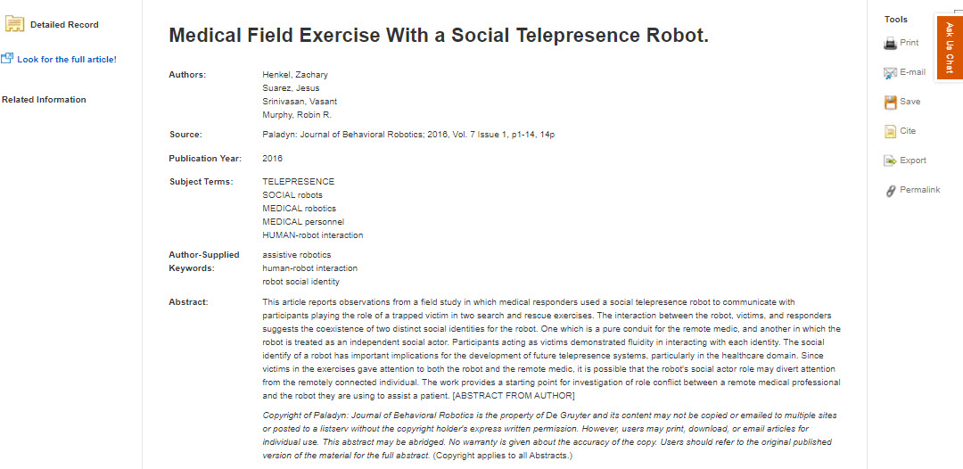
Notes:
If we click on the “Look for the full article!” link in the item record, we are taken to a page that looks like this:

Slide 31
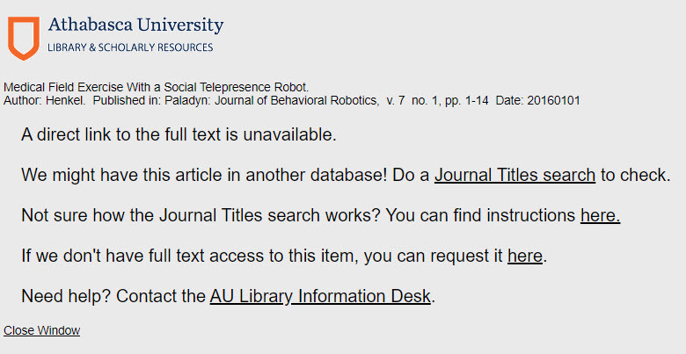
Notes:
Sometimes you will see a link that will take you directly to the article in another database. In this case, there is no direct link, but a link instead to the Journal Title List. By clicking on that, we can check to see if the journal is available in full text in a different database.

Slide 32
Notes:
Let’s do that now. To carry out a Journal Title list search, you will need the article’s citation information. This can be found on this page, as well as in the item’s record on your Discover search results page. In this case, the article was published in a journal called International Research Journal of Business Studies, in Volume 12, number 1, in the year 2019.

Slide 33
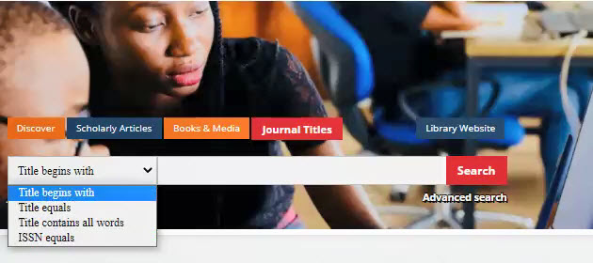
Notes:
You can also carry out this search from the Library’s homepage, which is where we are going to go now. The Journal Title search allows you to find out where the full text of specific journals can be found. It is the fourth tab on the search box. To search this tool, you enter the name of the journal – not the name of the article. If the search does not return a result, it means that we do not have direct full text access to this journal. You can search the Journal Title list in three different ways. “Title begins with” will search for the first words of the title; “Title equals” is the exact title (make sure you do not have any typos or omit words, or you will not find the journal), and “Title contains all words” will search for a few of the words from the journal title. I will do a “Title equals” search, as these keywords come up a lot in the titles of other journals.

Slide 34
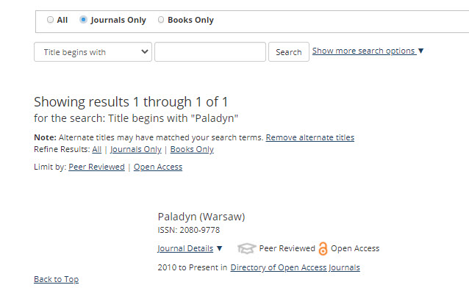
Notes:
After doing the search you can see that we have access to the journal through a collection called Directory of Open Access Journals. Often, we have overlapping coverage in some of our databases. Sometimes you will also see that different years are covered. In this case, I only have the one database to look in, and the coverage extends to the present.

Slide 35
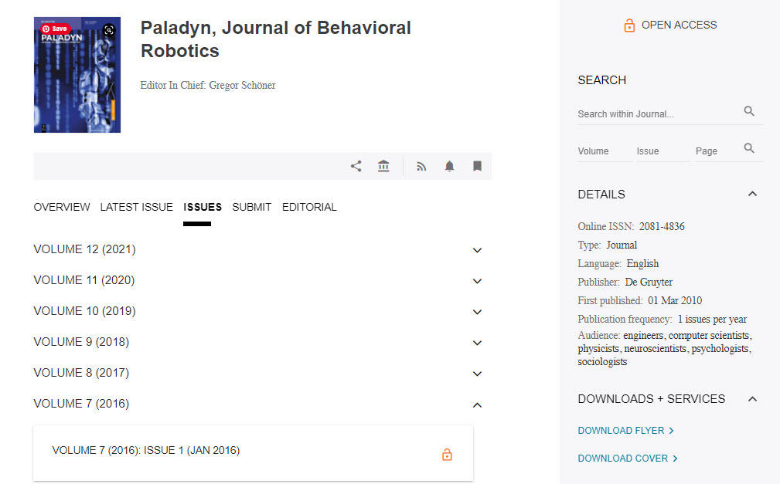
Notes:
The database link has taken me directly to the journal within the specific database, and from here we have access to all issues from 2008 to the present. First, I will click on “Archives”.

Slide 36
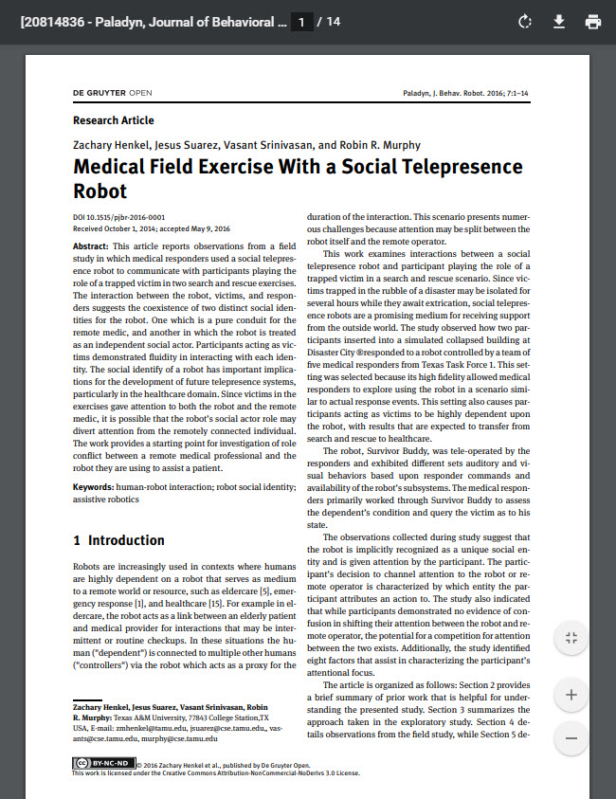
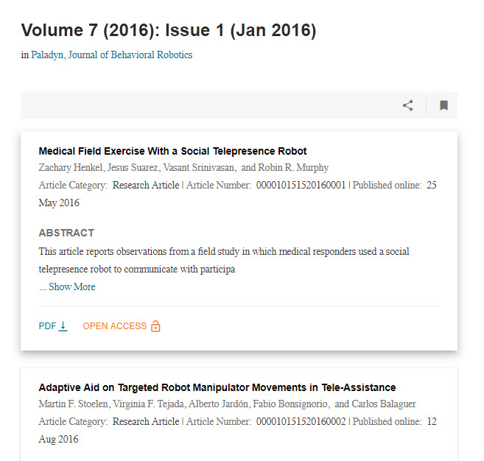
Notes:
I have the full citation for the item I am looking for, so I can now go directly to 2019, volume 12, issue 1 and find the article. If I only had a partial citation, I could click “Search” and do an author or title search to find the item. I can now download the PDF.

Slide 37
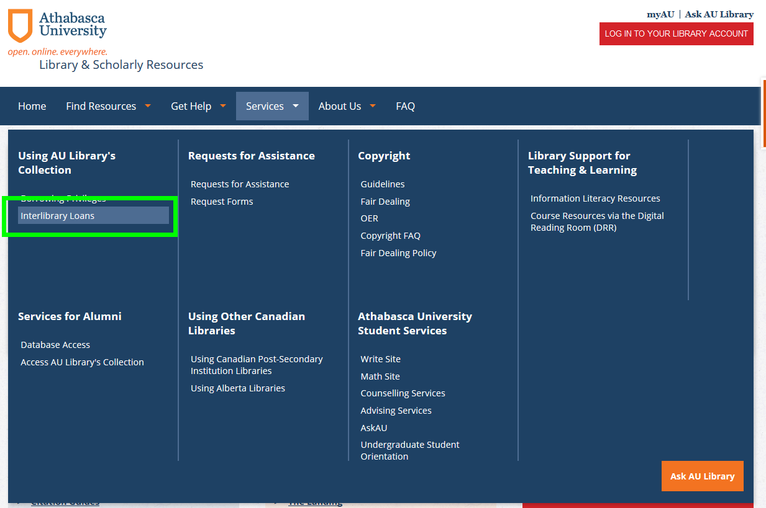
Notes:
If the Library does not have full text access to an article you need, you can place an interlibrary loan request. We will try to obtain the article from another library for you, and will send it to you via email as soon as possible. Please be aware that you will not get the article overnight, and it may take some time to receive the article. To place an ILL request from the Library homepage, go to “Services”, and under “Using AU Library’s Collection”, click on “interlibrary loans”.

Slide 38
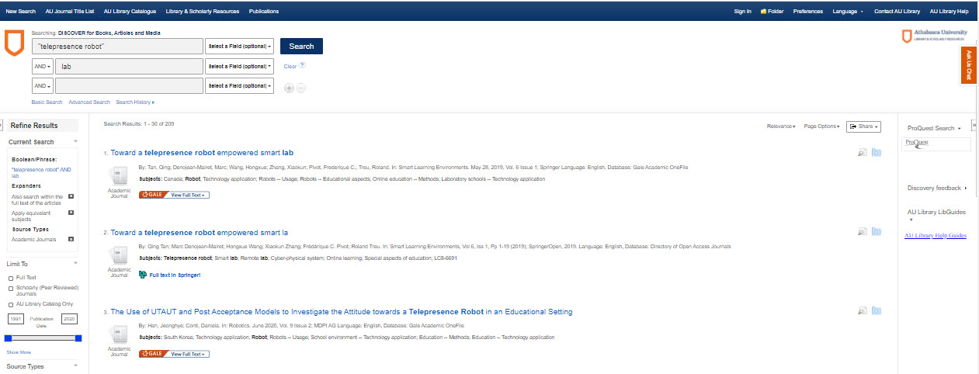
Notes:
One more thing about Discover. This tools does not index items from ProQuest databases. These collections are very good, so we have a shortcut you can use to search within them. On your Discover search results page, click on the ProQuest button on the right.

Slide 39
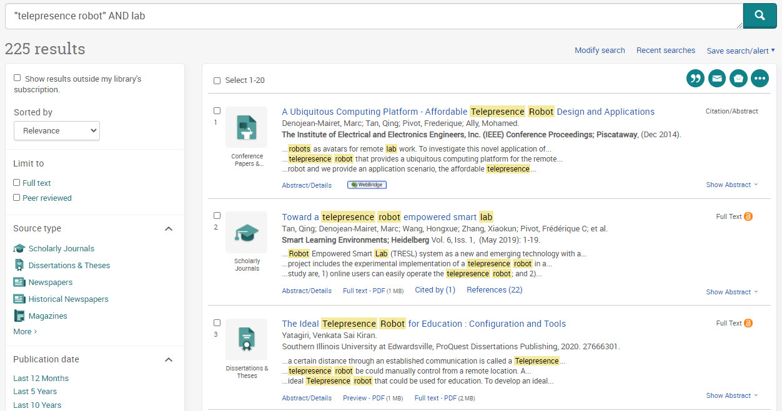
Notes:
This will populate your search terms in ProQuest. You will have to add your search limiters again, which you can do on the left.

Slide 40
Computer Science databases
2
+
2
+
Notes:
Of course, we offer more than one Business and Management database.

Slide 41
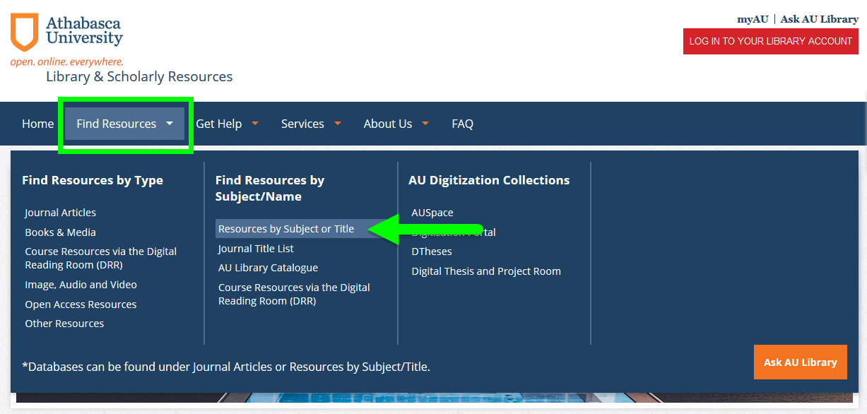
Notes:
So that’s Discover. Now I will show you how to search in a specific database. You might want to do this because Discover does not search all of our databases, or because a database contains particular journals or search features. If you know what database you want to search, you can go directly to it. Click on “Find Resources”, and then “Resources by Subject or Title”.

Slide 42
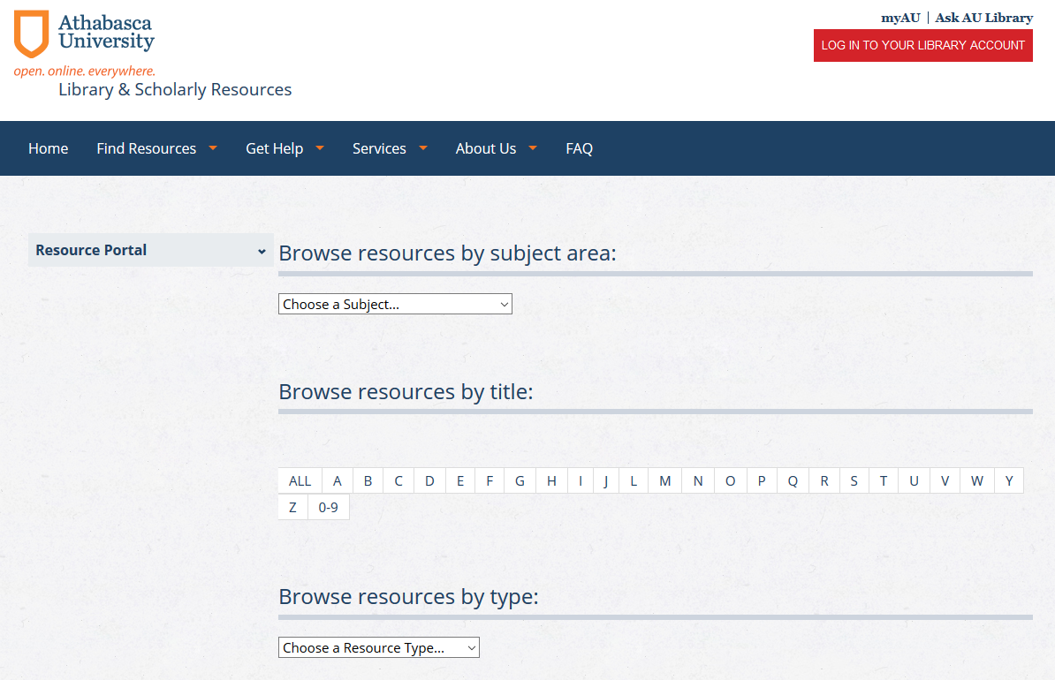
Notes:
On this page, you can view our resources by subject, alphabetical listing, or by type.

Slide 43
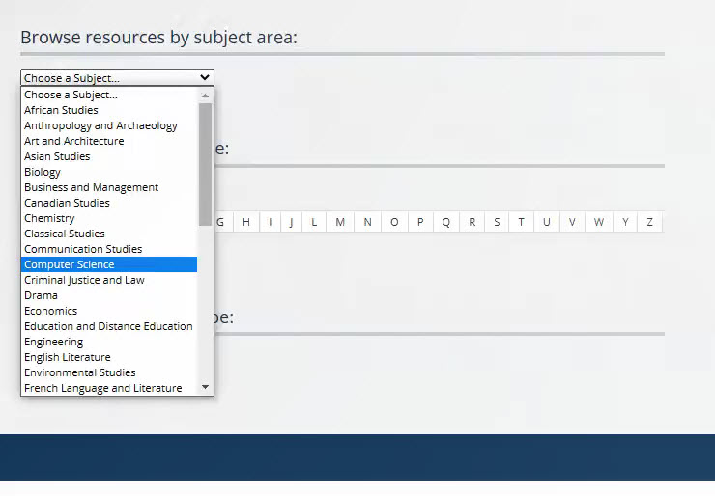
Notes:
To see our Business-related collections, select Business and Management from the drop-down menu.

Slide 44
2
+
Access Science
Advanced Technologies & Aerospace Collection
ACM Digital Library
arXiv
Cite Seer
Computer Database
Computer & Applied Sciences Complete
CoRR
IEEE Xplore Digital Library
IEEE/IEE Electronic Library
IGI Global
ProQuest Advanced Technologies & Aerospace Database
SciTech Premium
Notes:
Other collections I recommend include: ABI/INFORM, Business Source Complete, CBCA Business, Economist Intelligence Unit, Euromonitor, Hoover’s Company Profiles, Standard and Poor’s NetAdvantage, Stratfor Worldview.

Slide 45
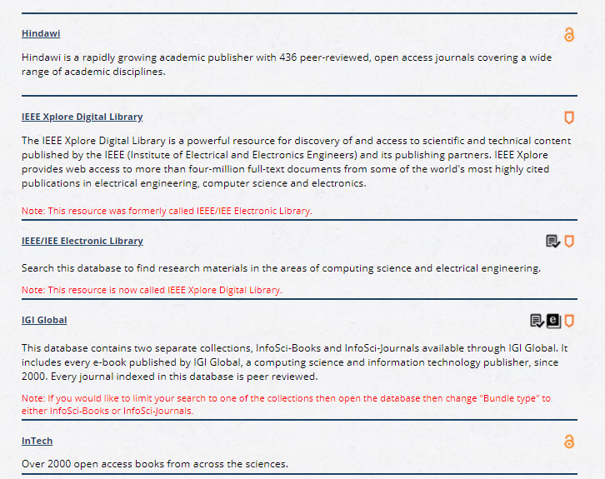
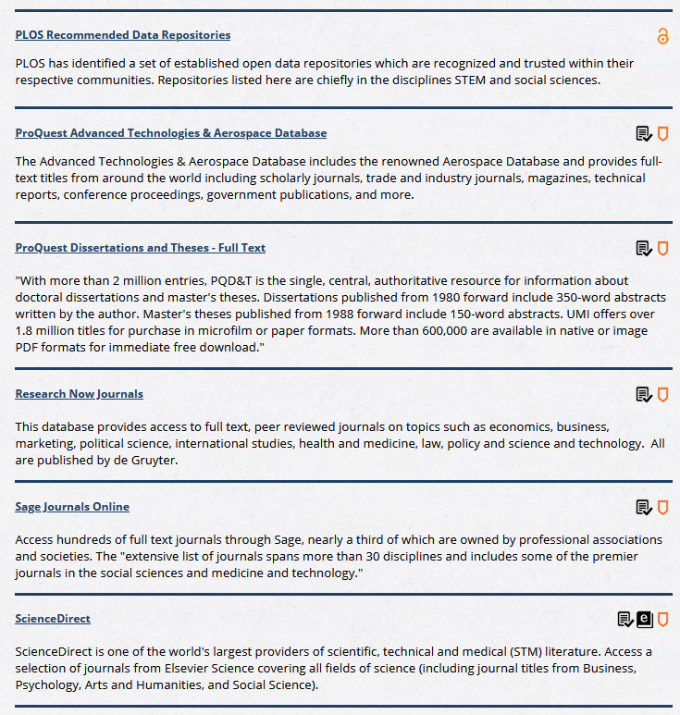
Notes:
We’ll do a search in the database ABI/INFORM. It’s the first results on the list, and it’s a very useful resource for business-related materials.

Slide 46
Research topic
2
+
Research Question
Keywords
What role do ethics play in self-driving car design?
Notes:
Before we get there, though, let’s quickly go over Boolean searches. For our practice database searches, we are going to use this research question: How does an organization’s culture impact the job satisfaction of women? The first thing I will want to do is break this topic down into discrete themes or concepts, and then come up with as many synonymous search terms or keywords that I can. Our search terms could include: Organizational culture, corporate culture, job satisfaction, employee satisfaction, women, females, female employees.

Slide 47
Research topic
2
+
Research Question
Keywords
Ethics, decision-making, accident, fatality, crash, moral, compliance
Self-driving car, autonomous automobile, self-driving vehicle, driver-less car
Design, manufacturing, engineering, compliance
What role do ethics play in self-driving car design?
Notes:
Before we get there, though, let’s quickly go over Boolean searches. For our practice database searches, we are going to use this research question: How does an organization’s culture impact the job satisfaction of women? The first thing I will want to do is break this topic down into discrete themes or concepts, and then come up with as many synonymous search terms or keywords that I can. Our search terms could include: Organizational culture, corporate culture, job satisfaction, employee satisfaction, women, females, female employees.

Slide 48
Boolean Operators
2
+
OR will expand your search results
AND will limit your search results
NOT will limit your search results
Careful with using NOT – you may exclude useful results!
Notes:
Next, you want to connect your search terms using Boolean operators. Boolean operators are simply AND, OR, and NOT. You use OR to search for similar keywords, for example, organizational culture or corporate culture. This will expand your search results as the database will search for articles described with both keywords. You can use AND to search for articles that link different concepts, for example, job satisfaction and women. You can use NOT to exclude results; for example, women not men. Be careful when you use NOT, however, as using NOT can exclude search results that might be useful to you. If there was an article comparing job satisfaction for women and men, it would not display in your search results because you excluded men.

Slide 49
Helpful Tips
2
+
Include alternate spellings when necessary; for example, driverless or driver-less
Using the truncation symbol * will search for all words with a similar root; e.g., ethic* = ethical, ethically, ethics, etc.
Using “quotation marks” will search for phrases, e.g.; “telepresence robot”.
Use round brackets (called nesting) to link your related concepts; e.g., ("self-driving car" OR "self driving car" OR "self-driving automobile“) AND (ethic* OR decision-making OR accident OR fatalit* OR crash OR moral*)
Notes:
Here are some more hints. If you place the star symbol (*) at the end of the root of a word, the database will search for all words with that same root; for example, profit* will search for profit, profits, profitable, etc. Be a bit careful with truncations; wom*, will search for women, wombats, wombs, etc. which are all very different concepts! Always put your truncation symbols as close to the end of the word as possible. Putting quotation marks around your phrases keep the terms linked. That is, the database will retrieve results with both words right next to each other, instead of separately. You can also use brackets, called nesting, to link related concepts in your search.

Slide 50
Putting it all together
2
+
("self-driving car" OR "self driving car" OR "self-driving automobile" OR "self driving automobile” OR "autonomous vehicle" OR “self-driving vehicle" OR “self driving vehicle“ OR “driver-less car”)
AND
(ethic* OR decision-making OR accident OR fatalit* OR crash OR moral*)
AND
(design OR manufactur* OR engineer* OR compliance)
Notes:
Here is what a complete search string might look like. Culture* will search for cultures, while female* will also search for females, and employee* will also search for employees – the truncation is a simple way to include the plural. In some databases, you can use separate search boxes for each term, while in other databases, you can or must enter an entire search string in one box. Remember to use the correct Boolean operators!

Slide 51
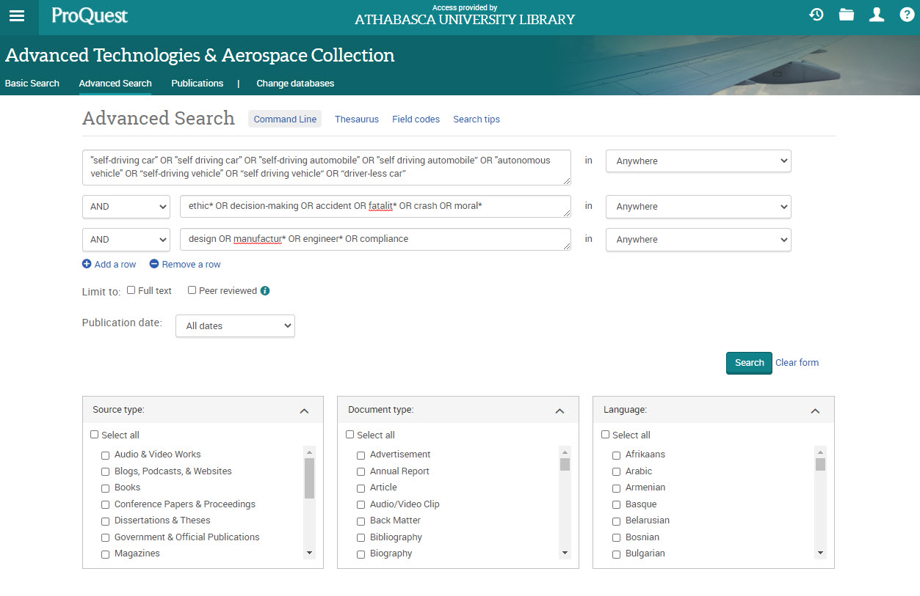
Notes:
So let’s go back to our database and try a search. In this database, you can put the entire search string in one search box. Remember to use nesting brackets for your related terms if you do so.

Slide 52
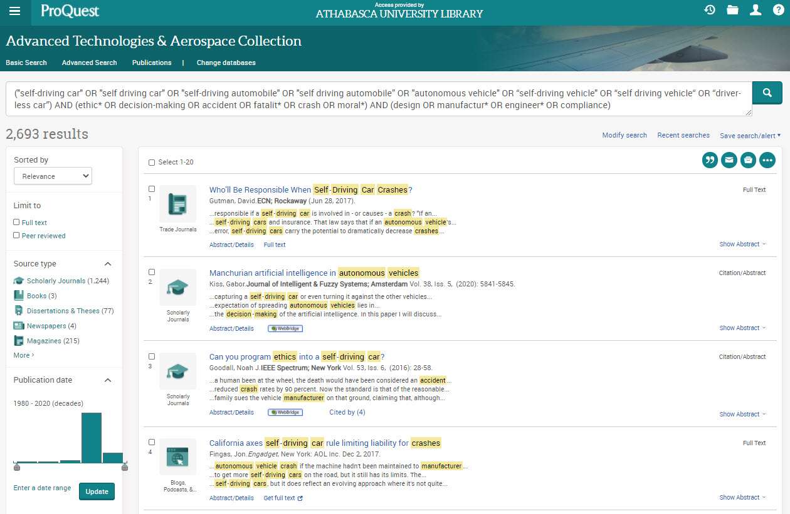
Notes:
Either way you search, it will yield the same number of results. In this case, we have over 11,400. Again, you can use the limiters on the left-hand side to refine your search.

Slide 53
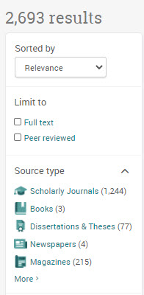
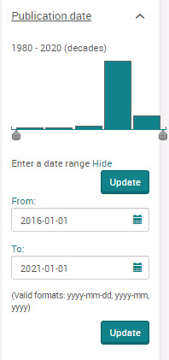
Notes:
We will limit our results to “Scholarly Journals” by clicking on the hyperlink. I’ll also limit to articles published since 2016 by entering a date range of 2016 to the present day.

Slide 54
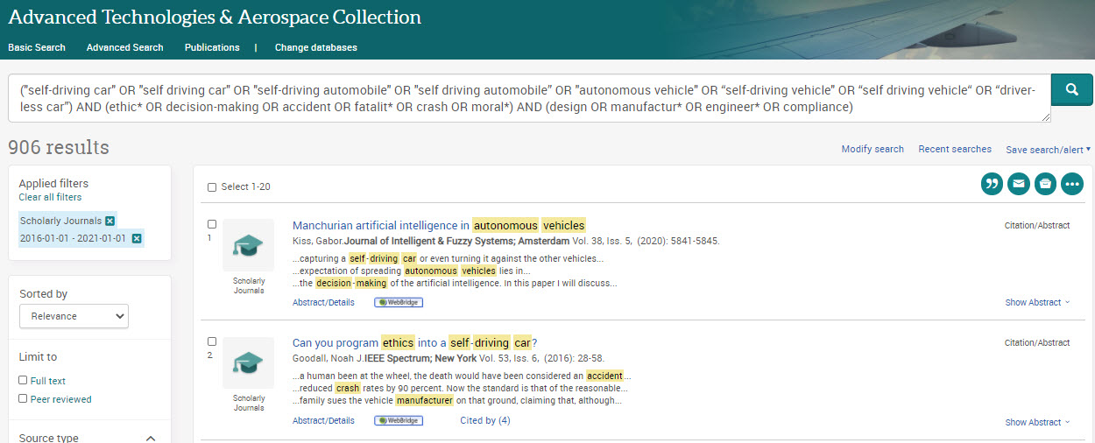
Notes:
This has refined our search to just under 2500 results. This is still a pretty large results list, and some of my results don’t seem all that specific to my topic. I’m going to modify my search by adding search field types.

Slide 55
Notes:
I’ll click on modify search.

Slide 56
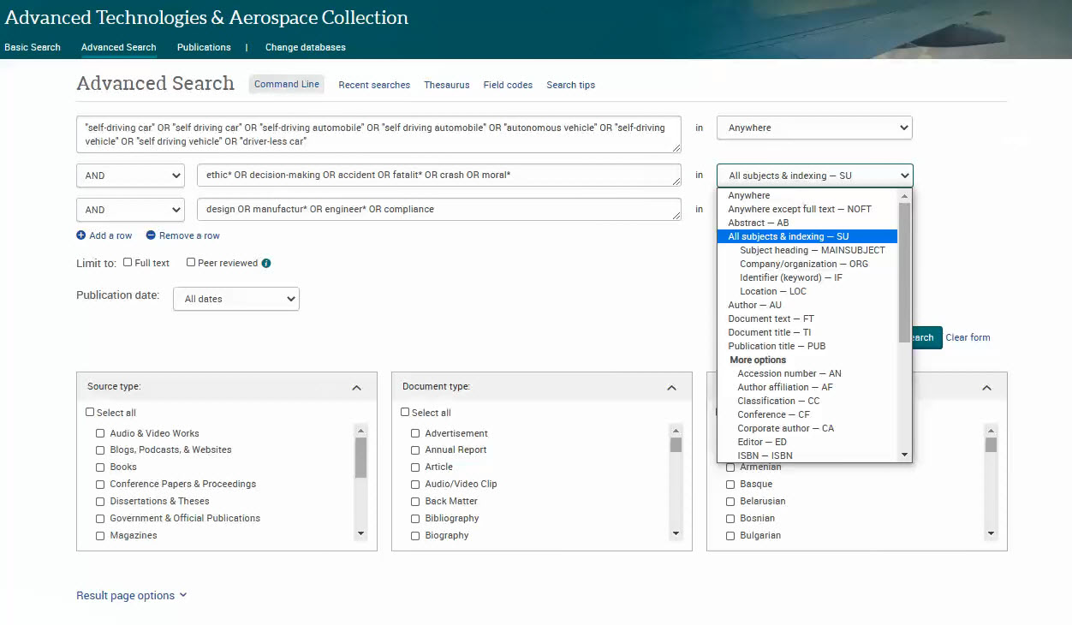
Notes:
In the field heading next to women-related keywords, I’ve selected “Subject heading”. This will limit my results to items in which these keywords appear in the subject headings associated with this article. This will ensure that my search results are specifically about women employees.

Slide 57
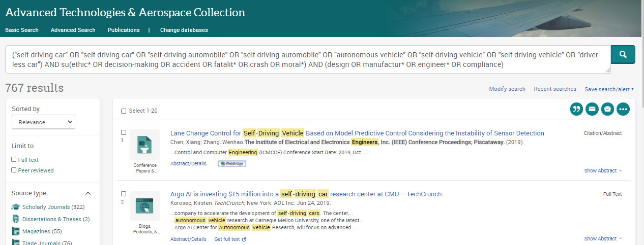
Notes:
This will leave me with 469 results to look at. I have to go and add my date and scholarly journal limiters again.

Slide 58
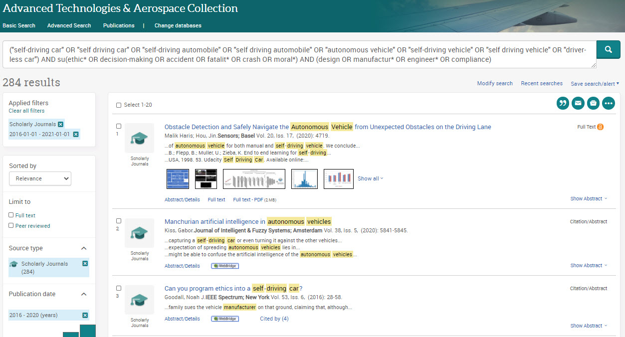
Notes:
Once I do so, I will have only 115 results left.

Slide 60
Notes:
Once you find a resource that looks useful, take a look at the full record by clicking on the hyperlinked article title. The full record shows you the abstract, citation information, and most importantly, subject terms.

Slide 61
Notes:
On the right, you can email the article to yourself, save it to your computer or storage device, or export it to your citation management software account – click on “Save” to do so. If you want to print the item, it is better to download the PDF and print from there, because this print link will only print the citation page.

Slide 62
Notes:
You can also use the helpful “Cite” function, which shows you what a reference citation for this article would look like in a variety of formats, including APA, MLA, and Chicago.

Slide 63
Notes:
I will finish up our database search portion by showing you the very useful “Recent searches” function. You can click on this link to see all of the searches you have made, all of the changes you’ve made to them (including limiters and search terms added or removed), and the results of those searches. Keep in mind, though, that when you leave the database or close the browser window, the search history will not be saved. You can print the search history if you want to keep a record of it. Click on “Export all searches” to save your search record as a PDF, in RTF or HTML format, or as a text file. Discover has this function, called “Search History”, though not all databases do.

Slide 64
Getting research help
2
+
2
+
Notes:
Finally, I want to leave you with the message that the Library is here to help you!

Slide 65
Notes:
Grad students, like yourselves are often dealing with so many sources you do want to think about how you will organize them. Check out our Keeping organized webinar, you can find a recording of this as well as upcoming webinars on our orientations page: http://library.athabascau.ca/orientations.html

Slide 67
Notes:
Please visit our “Contact Us” page on the Library’s homepage for our contact information. You can email us or give us a call during our business hours (8:30 to 4:30, M – F, Alberta time) and we will get back to you as soon as possible. Our Reference Librarians can help you to come up with a search strategy if you are having difficulty with this, and our Library staff can help you with accessing materials.

Slide 68
Notes:
Our contact us page also contains a link to our new FAQS. Here, you can search for answers to your basic questions about Library resources and services.

Slide 70
Notes:
We also offer live chat services from 10:30 am to 2:30 pm Mountain Time. You can click on the “Ask Us” chat widget on the top right of the homepage screen during these hours to chat live with a library staff member.

Slide 72
THANK YOU!
2
+
2
+
Questions?
Notes:
Thank you for your attention! Do you have any questions?

