Slide 2
Research Cluster is…
A HOTSPOT of interest at the university
A group of researchers, students and other interested people working on a focussed area.
Promotes ideation, cross fertilization of ideas, funding proposals for large projects, and action on smaller projects.

Slide 3
How you can be involved…
Cluster
Associate Member – for interest, join the contact list, actively participate in meeting discussions and blogs
Research Member – active participant in researching or developing virtual agents at AU

Slide 4
Research Clusters
Virtual Agent Lab

Slide 5
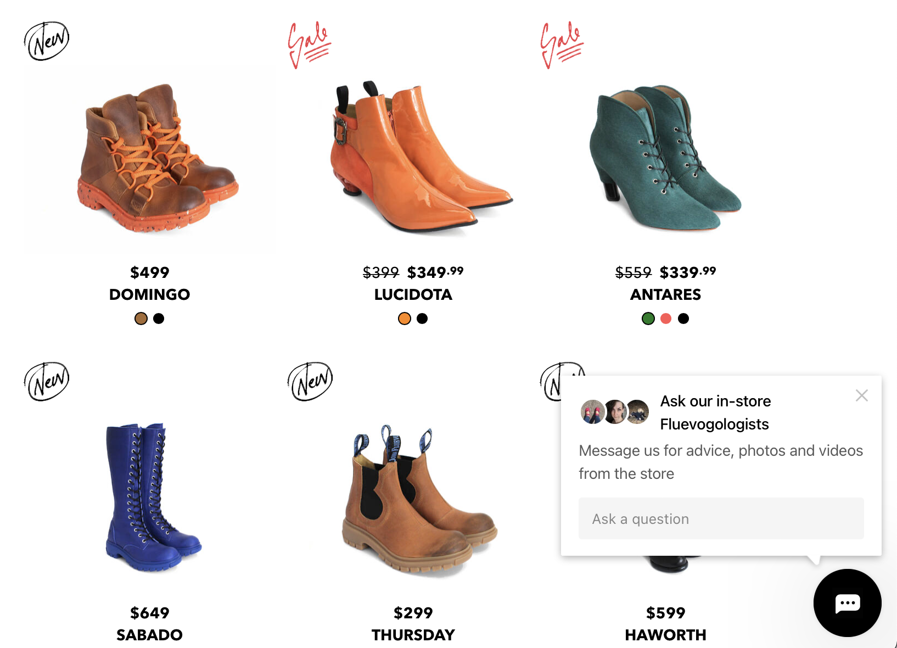
Virtual Agents are…
And used for:
(improved) customer experience
Service provision
Agent to agent communications for service
Education
Personal assistants
Health and wellness

Slide 6
For students, this cluster will provide opportunity to:
learn about the theoretical bases of virtual agents
learn about the application of virtual agents
learn about ethics in the application of virtual agents
connect with professors who might then become their supervisors
present their research and receive feedback
discover funded opportunities for in the field of virtual agents.

Slide 7
Why students get involved…
Benefits – connection to research base of AU, provides experience how research theory gets applied to innovation and transfers to the workplace.
Involvement – Access to relevant literature and research presentations on virtual agents; feedback and presentation opportunities for own research on virtual agents.

Slide 8
Research focus:
Application and advancement of virtual agents as pedagogical devices
Application and advancement of virtual agents as student learning companions
Ethical challenges of the use of virtual agents
Cluster focus:
Reviews technology and operations of virtual agents and multi agent system
Case studies of virtual agents and their uses / operations

Slide 9
VA Lab in 2022
March 4th
Overview of VA Lab
August 5th
Feedback from CUI 2022
September 1st
Discussion - chatbot in educational service
April 1st
May 6th
What is a conversational agent.
FreudBot project with Bob Heller
Alexa Prize.
Notes:
Trying out different types of meeting…
Practice and discovery session – cluster focus
Research project presentation – research and cluster focus
Conference feedback – research focus
Discussion of service chatbots (in education…Asim’s experiences at U of A) – cluster focus
Nov will be paper reviews for educational bots case review – research and cluster focus
What works? Variety maybe. Discussion is appreciated by professional employees at AU.
What can be done better? Advertising. Student participation (they are very passive).

Slide 10
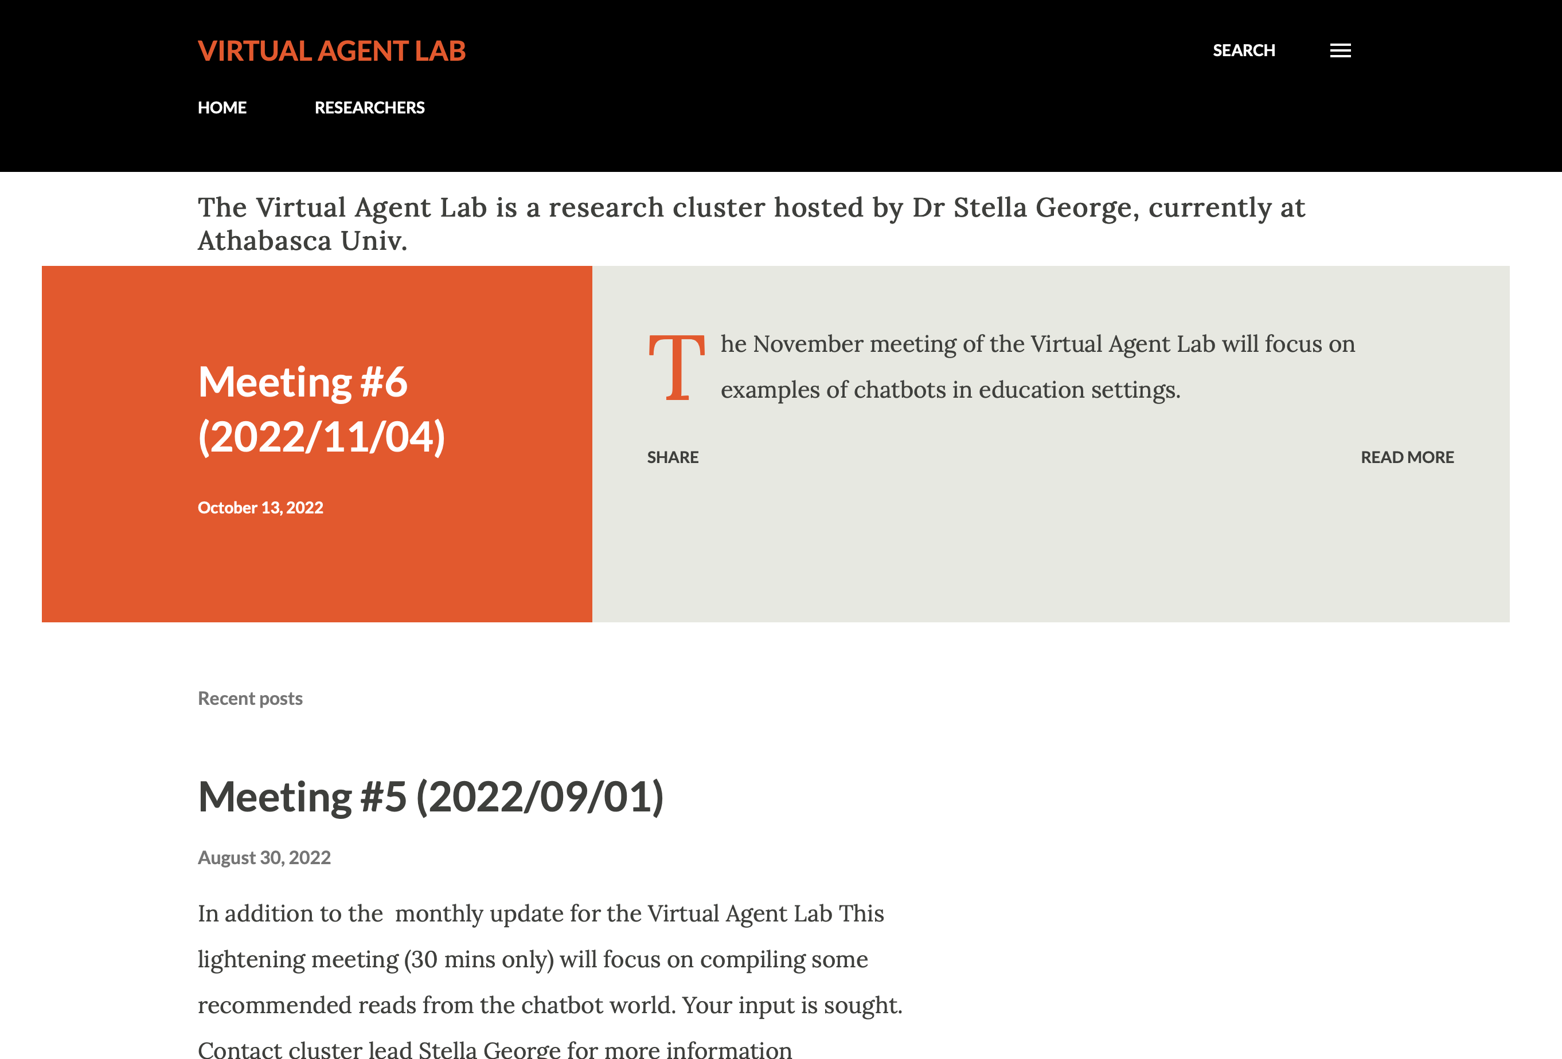
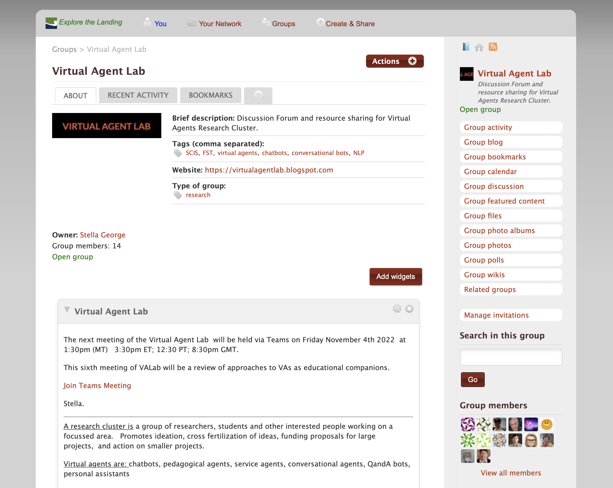
DETAILS
https://landing.athabascau.ca/groups/profile/12483512/virtual-agent-lab
EXTERNAL
https://virtualagentlab.blogspot.com

