Slide 1

THE FACULTY OF GRADUATE STUDIES AND YOU
2022 ORIENTATION

Slide 2
WELCOME TO ATHABASCA UNIVERSITY, TO THE FACULTY OF GRADUATE STUDIES, AND TO FST

Slide 3
Speakers
Simon P. Sigué, Associate Dean Operations, FGS
Heather Purchase, Graduate Awards Scholarship Liaison Officer, FGS

Slide 4
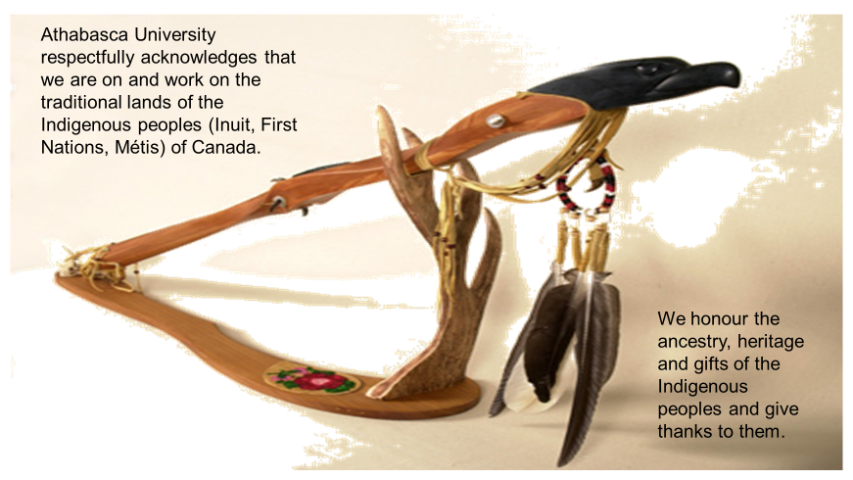
Land acknowledgement

Slide 5
Contents
FGS in brief
Profile of AU Graduate students
Graduate Student Handbook
Graduate funding opportunities & scholarships
Events and activities of interest to graduate students
When to interact with FGS?

Slide 6
WHAT IS A FACULTY OF GRADUATE STUDIES?

Slide 7
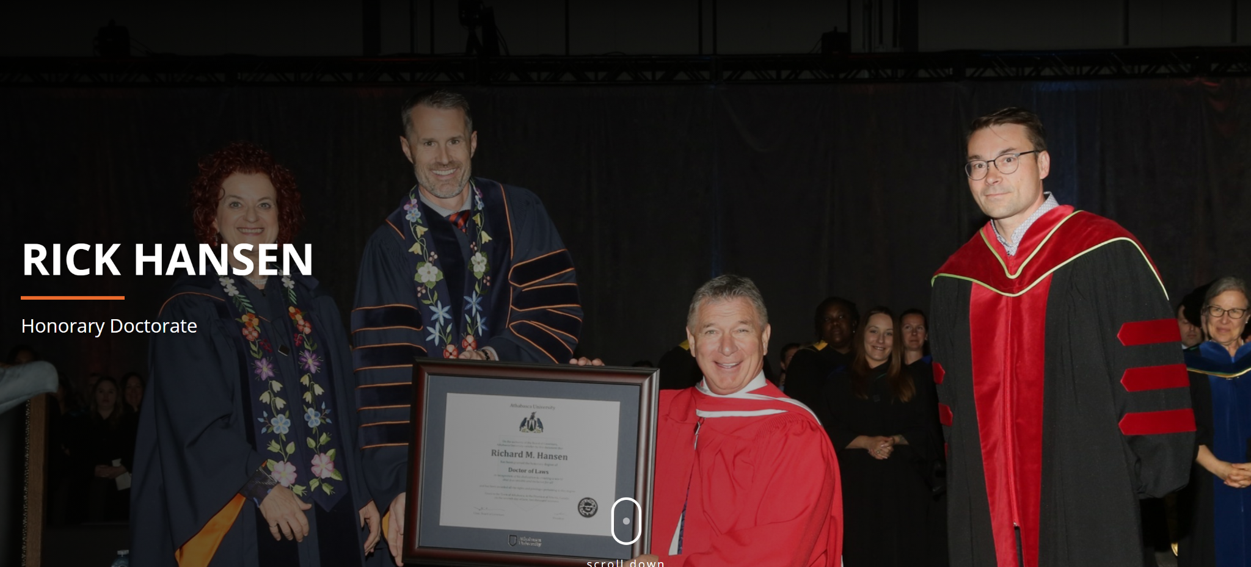
Purpose
The primary purpose of the Faculty of Graduate Studies is to define and support excellence in graduate education and the research and scholarly activities associated with it.
fgs.athabascau.ca

Slide 8
What do we do?
Provide oversight for high-quality and rigorous academic programs.
Develop minimum standards across all graduate programs.
Ensure policies are implemented fairly and consistently across all graduate programs.
Develop resources for faculty and students.
fgs.athabascau.ca

Slide 9
WHO ARE AU GRADUATE
STUDENTS?

Slide 10
AU graduate student profile
Average age of AU graduate students at admission = 33.9 years
77.8% of graduate students are women (2021-22 data)
87.4% work while studying

Slide 11
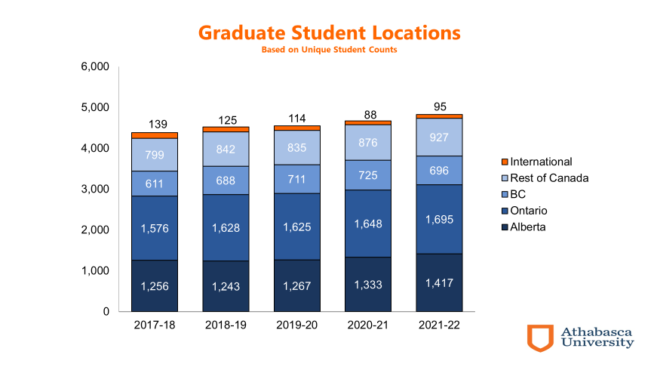
Where are they from?

Slide 12
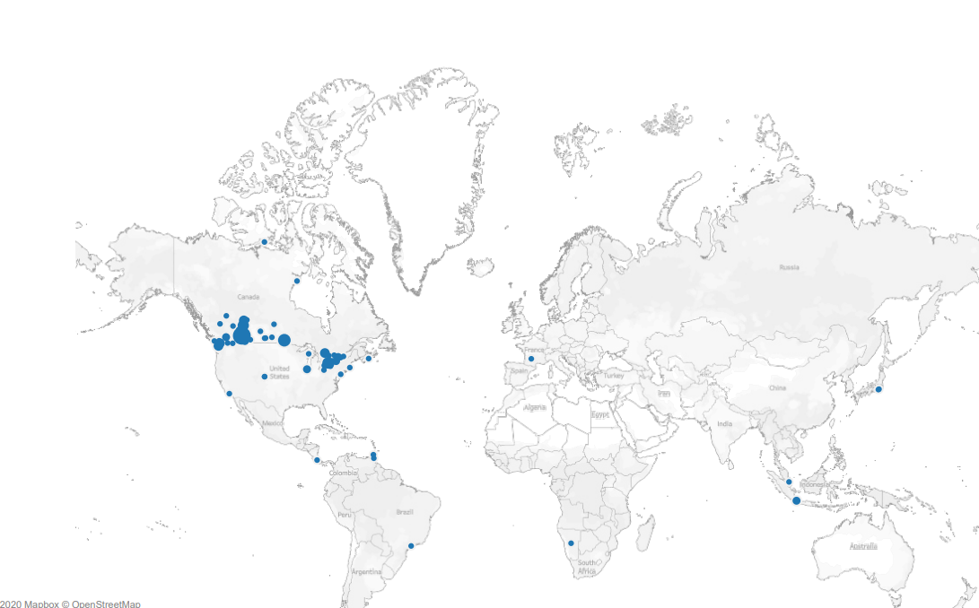
Globally

Slide 13
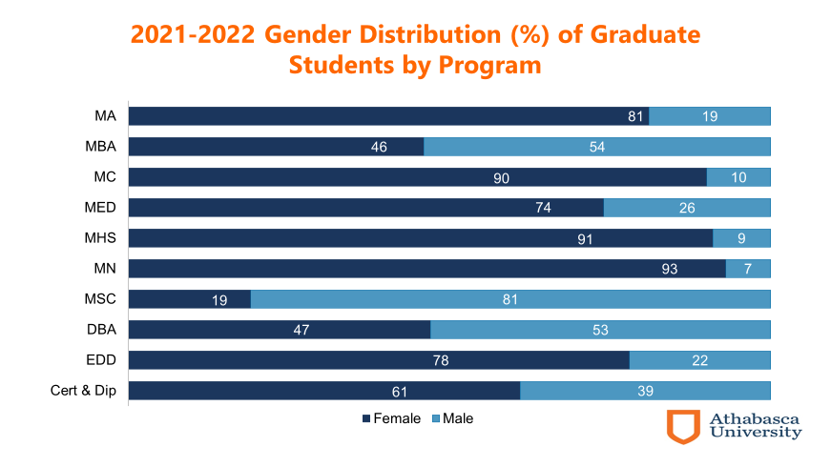
Graduate gender by program

Slide 14
GRADUATE STUDENT
HANDBOOK

Slide 15
The graduate student handbook
The Graduate Handbook covers all faculty policies, procedures, and regulations. From admissions to dissertations and more, the handbook is your guide to success in graduate studies at AU.
https://www.athabascau.ca/graduate-studies/resources/graduate-handbook/index.html

Slide 16
Graduate handbook features
Appeal process
Master’s and Doctoral study regulations
Copyright information
FGS forms
Oral exam guidelines
Program deferrals and extensions

Slide 17
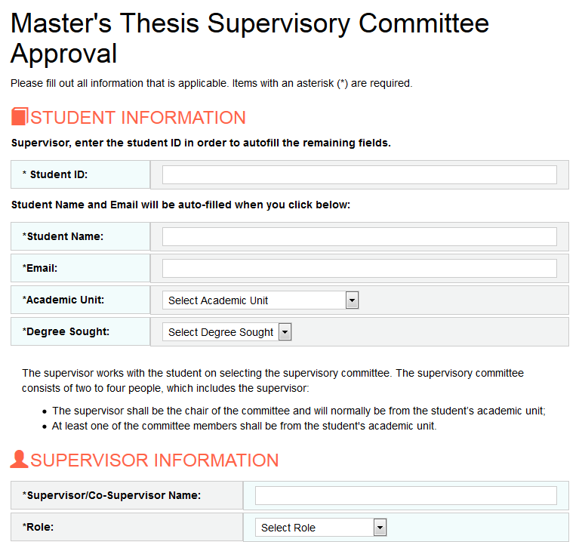
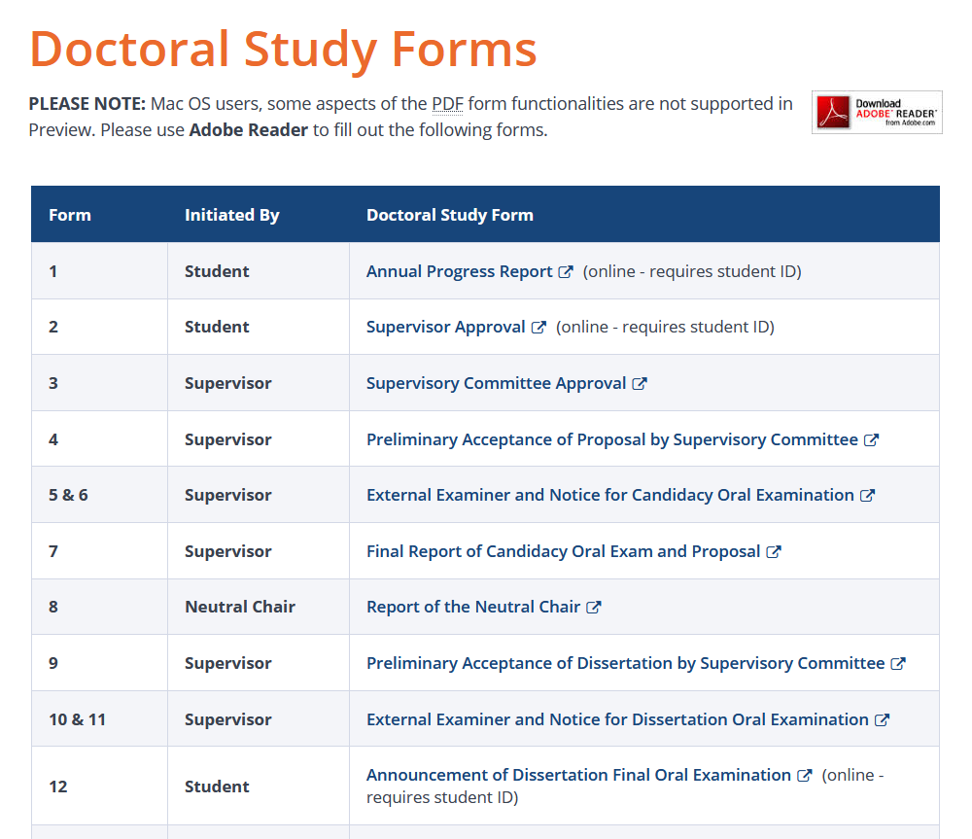
Faculty of Graduate Studies forms

Slide 18
GRADUATE FUNDING
OPPORTUNITIES & SCHOLARSHIPS
AT AU

Slide 19
In 2021-2022…
Application awards:
228 awards for a total of $511,000
  Success rate: 64%
Nomination awards:
65 awards for a total of $513,000

Slide 20
Current opportunities
Canada Graduate Scholarship—Master’s program
$17,500 for one year
SSHRC: 2; NSERC: 1; CIHR: 1
Alberta Innovates Graduate Student Scholarship
Up to $26,000/year for up to 2 years
Internal
Excluding open awards, there is approximately $530,000 available to masters and doctoral students at AU.
https://www.athabascau.ca/graduate-studies/about/graduate-funding.html

Slide 21
Questions about awards?
I’m here!
Email me any time at fgsawards@athabascau.ca.
Have a quick question? Find me in MS Teams.
Want to chat? Schedule a meeting or phone me at 780.691.2646.

Slide 22
EVENTS AND ACTIVITIES
OF INTEREST TO GRADUATE STUDENTS

Slide 23


News, events, & opportunities
Stay in the know with the Faculty of Graduate Studies by visiting our News and Events Page!
https://www.athabascau.ca/graduate-studies/news-events.html

Slide 24
Free professional development
Webinars
Non-credit courses
Workshops

Slide 25
LET’S
TALK!

Slide 26
Interactions with FGS
Annual Progress Report (APR)
Once you identify a supervisor, then you will become more involved with FGS
You will begin to work on your thesis proposal, then need a committee to provide you with expert advice and information to analyze your research problems
Then prepare for your proposal oral exam

Slide 27
We’re here to help.
We understand that life happens. Our students may experience many interruptions to their studies, such as:
Birth/adoption
Research delays
Illness
Work responsibilities
Self-doubt: “What have I gotten myself into!?”
Contact us at any time at fgs@athabascau.ca or reach out to the Support Services Team.

Slide 28
Thank you!
Find us:
Simon: simons@athabascau.ca
Heather: hpurchase@athabascau.ca
FGS: fgs@athabascau.ca
Awards: fgsawards@athabascau.ca
Twitter: @fgsathabascau.ca

