Slide 1

The Essentials of Presenting Your Work at a Conference
A workshop co-sponsored by
FGS and the Athabasca University Write Site
Linda McCloud-Bondoc, Write Site Coordinator
Notes:
Introductions

Slide 2

Introductions
  Name
  Program
What is one thing you know for sure about giving presentations?

Slide 3

The presentation iceberg
Engagement
Timing
Presentation
Context
Preparation
Material
Media
Self
Notes:
First we’ll look at preparation, then at presentation

Slide 4
Agenda
Preparing :
  For the context,
  The material,
  The media
  Yourself
Presenting:
  Engaging your audience
  Staying on time
View an example of a poor presentation
Goal: Assess a presentation: indentify some criteria/questions for assessment that you can apply to your own work.
View an example of a good presentation

Slide 5
Reflection: What makes this a good presentation?
  http://www.ted.com/talks/andrew_mcafee_what_will_future_jobs_look_like.html: (3 min.)
  Identify one thing that you think makes this a good presentation.
  The material
  The presenter
  The use of media
  Please enter your answers in the chat box.
Notes:
Don’t’ focus on the content; focus on the presenter, what he does, how he does it.
Watch the first 3 minutes, then come on back
Possible answers:
Uses humor to engage his audience
Unexpected juxtaposition
Uses all visuals and narrates
Gets to the main point quickly: new machine age=more machines, more unemployment, good news(?!)
Easy to follow, speaks clearly
Lots of gestures and moves

Slide 6
Preparing
Context
Preparation
Material
Media
Self
Notes:
We’re going to start with the largest part of iceberg, the preparation
We’ll talk about preparing for the context, preparing the material and the media and preparing yourself

Slide 7

Prepare for the context
Who is your audience?
What is the presentation’s
broad purpose?
How many will you be presenting to?
Will it be a physical or virtual space?
If virtual, will it be a synchronous or asynchronous presentation?
Notes:
If we could be a fly on the wall when Andrew Mcaffee started to prepare for his presentation, we might hear him mulling over some of these questions
Tips:
These are questions to ask BEFORE you start to prepare your presentation. This is like prewriting
Remember that this is not the same audience that you prepared your thesis for. It is not an examining committee. Thus, you can assume knowledge from a peer audience that you might not be able to with a committee.
If possible, do some research on your audience or make some informed assumptions.

Slide 8
Prepare for the context: Pace and time your presentation
How much time have you got?
Should you plan for a question period?
Notes:
Tips:
Plan for less time than you’ve got
Remember that you will talk faster in the presentation than in rehearsal
Designate certain slides to skip if you’re running short of time
Do a complete run-through for timing
Plan on using your question period in case you are over or under time
These are all decisions you should make BEFORE you begin to prepare

Slide 9
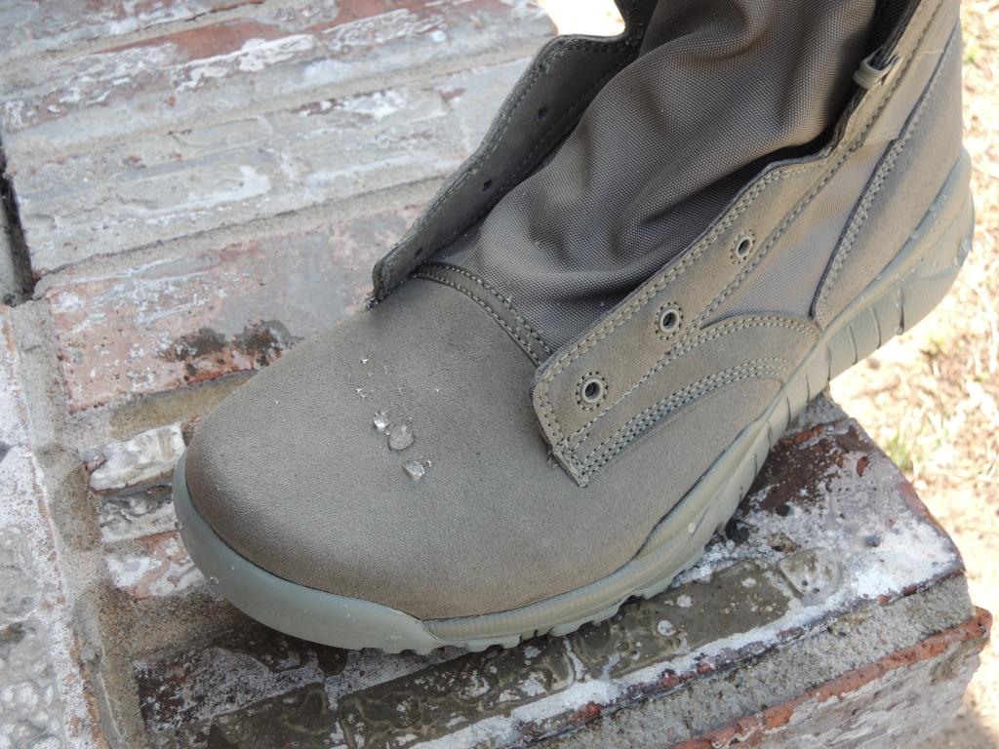
Prepare the material: Put yourself in your audience’s shoes
What is the main point/takeaway message for your audience?
What parts of your research would be most interesting for them?
Notes:
Focus on the essentials
Tips:
How not to include too much: Focus on your main message.
With each slide ask: will my audience be interested?
Focus on your end message: often the discussion section
Avoid slides packed with stats or figures
Simplify complex information

Slide 10
Prepare the material: Arrangement
Provide a road map for your audience
End (Main message)
Middle
Beginning
Notes:
Tips:
Think of your presentation as a road map that is leading your audience to your main findings/message.
Does the material lead your audience to your main focus: your findings/message?
Does the material have a natural and obvious flow to it?
Have you told the story of the journey of your research in a way that is understandable to your audience and contains only the necessary elements?
Does your presentation follow a logical structure, i.e., the process or chronology of your research?

Slide 11
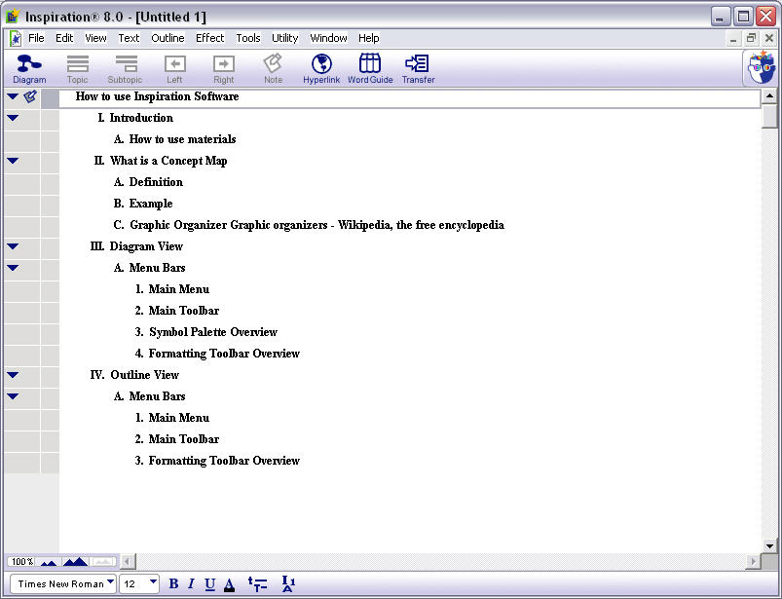
Prepare the material: Arrangement
Do an outline
View credit: http://mentor.ucs.indiana.edu/~frick/r547/2006/inspiration/conceptmap.html
Notes:
Tips: Do a formal topic outline if you are one of those concrete sequential thinkers that liked the written agenda
There are software programs that will help you with this.

Slide 12
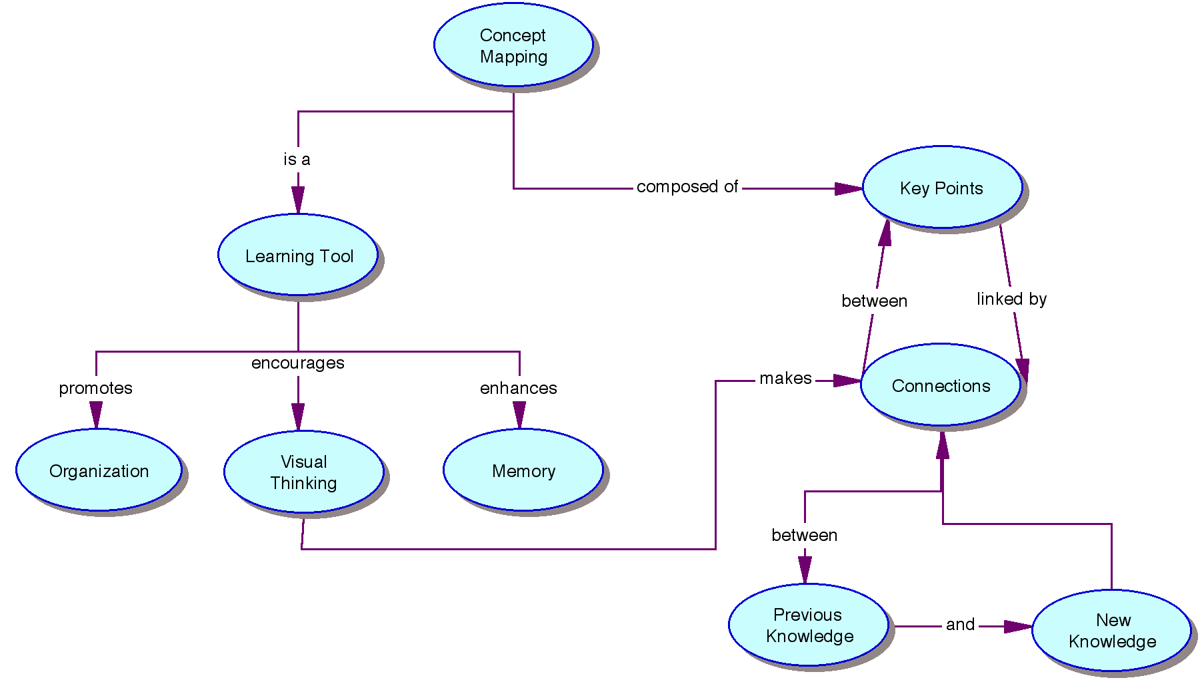
Prepare the material: Arrangement
Or a concept map
View credit: http://mentor.ucs.indiana.edu/~frick/r547/2006/inspiration/conceptmap.html
Notes:
Tips: Do a concept map if you are a more abstract/random or visual thinker.

Slide 13
Prepare the material: Arrangement
As you watch this introduction, consider:
  Do you know his main message?
  Do you know how he will develop this message?
  Do you know what to expect next?
  http://www.youtube.com/watch?v=8K720D6nwkc
Notes:
I’m not going to ask you to answer out loud, so just think about these questions as you watch.
(Warning: you might get an advertisement)

Slide 14
Prepare the material: Arrangement
Tell what you’ll tell them
Tell them
Tell them what you told them
Notes:
This illustrates another important aspect of arrangement: the need for repetition.
The introduction should preview the main points,
The middle should elaborate on those points and
The end should summarize the main message.
Remember that you’ll be speaking and your audience will be listening so repetition is key.

Slide 15
Prepare the material: Engage your audience
Have you planned to get to know your audience and have them get to know you in a way appropriate to the speaking occasion?
Have you planned a specific way of capturing your audience’s attention?
Have you built in repetition for understanding?
Notes:
Tips
You can use techniques like anecdotes, questioning
If your speaking occasion allows it, plan for audience activities.
Do you have an introduction to the topic, and an overview

Slide 16
Prepare the material: Question period
Notes:
Plan some strategies for stimulating discussion:
Plant questions, both rhetorical questions and ones that you will solicit answers for, at appropriate places in the presentation. In fact, I’d like to ask you:
(How long do you think a speaker should speak before planning a question or otherwise engaging their audience? ) A. 20 min B. 10 min C. 5 min
Click one of the options at the top of the screen.
Have you got a couple of seed questions that you can use to stimulate discussion…e.g. “while you’re thinking about your own questions, I can mention one question that almost always comes up when I discuss this topic with colleagues…
Once conversation starts, you can plan to switch to facilitating discussion: “that’s a really good point. But before I answer, are there any other thoughts about that?”
What if you don’t know? How would you respond to that?
Don’t be afraid to say “That’s a really good question, and I’m not sure about the answer. Can I get back to you on that? Or better still, what do the rest of you think about that?”
Some of these strategies will depend on the size of your audience. E.G. In a big crowd, it’s difficult to facilitate a discussion.
Timing: This is the place where you can make up time or expand a bit.

Slide 17
Prepare the media and for the media
Not all presentations require PPT
  E.g. Prezi
Be familiar with the technology that you are using
Don’t assume that equipment will be there: ask, check out the room, check available help, check locations of outlets, etc.
Use simple, relevant visuals
Notes:
Does the media fit the topic? (Not all presentations require PPT)
** Does the media fit the technology? This presentation is a good example of this.
Are you familiar with the technology you’ll be using?
Is all the equipment that you need in the place where you will need it?
Will there be an internet connection in the room you are assigned?
Is your font size appropriate to the size of the room?
Are your visuals informative?
Is all the equipment that you need in the place where you will need it?
Do you need supplemental materials

Slide 18
Prepare the media: Simplify visuals
Notes:
Are your visuals informative?
Do you need supplemental materials?
For example:
What questions do you have about this graph?
Needs context, explanation
Is this the best use of your time? Is there a simpler way you might portray your information?
Is there another way to present the material?

Slide 19

Prepare yourself
Prepare speaker’s notes
Notes:
Tips:
DON’T read from your speakers’ notes
it can be boring ( hearing readings of fiction prove that it doesn’t have to be so.)
Have you written notes that covey “must tell” points: material that conveys essential points?
Have you practiced the presentation, gotten feedback, and made any necessary changes?

Slide 20
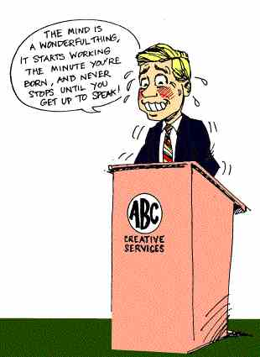
Prepare yourself
Prepare for cases
of “nerves”
Notes:
Tips:
Have you practiced the presentation, gotten feedback, and made any necessary changes?
Is your presentation within the time limit?
Have you practiced?
Do you have a plan if you go overtime or are under-time?
Do you have a strategy for relaxation: breath control, pausing, smiling,
Sometimes it helps to expect something to go wrong: let it go, pick it up where you were and move on. Positive self talk, body awareness: consciously relax your shoulders. Have some water handy
Have you practiced that?
Think of your audience as friendly and supportive—they usually are.
Have you practiced?
Have you let your passion shine through in the practice sessions?

Slide 21
Giving the presentation
Engagement
Timing
Presentation
Notes:
Tips:
Have you practiced the presentation, gotten feedback, and made any necessary changes?
Is your presentation within the time limit?
Have you practiced?
Do you have a plan if you go overtime or are under-time?
Do you have a strategy for relaxation: breath control, pausing, smiling,
Sometimes it helps to expect something to go wrong: let it go, pick it up where you were and move on. Positive self talk, body awareness: consciously relax your shoulders. Have some water handy
Have you practiced that?
Think of your audience as friendly and supportive—they usually are.
Have you practiced?
Have you let your passion shine through in the practice sessions?

Slide 22
Giving the Presentation:Engagement
Are you speaking too slowly or too quickly?
Are you making appropriate eye contact with your audience or otherwise involving them?
Do you smile in the appropriate places or otherwise engage your audience?
Are you B-R-E-A-T-H-I-N-G?
Notes:
Tips:Engage and involve your audience
If you have a flair for the dramatic, use it. Otherwise, use other techniques like anecdotes, questioning. Work with your own style
Vary your speech pattern and tone
Use hand gestures, walk back and forth across the stage(with caution), and come out from behind the podium.
If you’re online, and don’t have those visual cues, think about how you will engage your audience, e.g., questions, activities, visuals, multimedia

Slide 23

Giving the Presentation
  Keep an eye on the time
Notes:
Tips:
Put a watch where you can see it or make sure you have a view of BIG clock
Ask the moderator to give you a high-sign when you’re half way, or 10 minutes from the end of your time.
Skip slides if you’re running behind.
Keep in mind that if you finish early, no one will mind. If you’re late, it throws everyone off.

Slide 24
Breakout activity:10 minutes
Video of a presentation (2.5 minutes)
http://www.youtube.com/watch?v=TtraR3gezQw
You will be assigned random groups
You will be able to talk among your group members
Assign a group reporter
You will return to the large group and discuss your findings.
5 minutes

Slide 25
Breakout activity:10 minutes
Out of 10, how would you rate this speaker?
What would you advise this speaker to change?
  Consider:
Preparation:
Context
Material
Self
Media
Presentation
Notes:
What would you advise this speaker to change Areas include: presenter, content, use of media
List of possible answers:

Slide 26
Discussion
Group reports:
What was your rating?
What advice would you give to this speaker:
  Preparation:
  Context
  Material
  Media
  Self
  Presentation

Slide 27
What are two questions you are going to ask about your work ?

Slide 28
Questions?
Notes:
What have you tried for nerves?
Collect on the white board.
I will compile these along with some of the other questions I’ve asked and send them around after the presentation

Slide 29
Where to go for help
AU Write Site:
http://www2.athabascau.ca/services/write-site/coaching.php
Write Site Coordinator:
lbondoc@athabascau.ca

