Slide 1
Critical Thinking strategies for graduate assignments
Workshop co-sponsored by
Faculty of Graduate Studies &
Centre for Learning Design and Development
October 23, 2013

Slide 2
Agenda
11:00 – Welcome/Roundtable on your perspective
11:10 – Working definition of Critical Thinking
11:15 – Education perspective: Derek Briton
11:25 – Information Literacy/Research perspective: Elaine Fabbro
11:50 – Writing perspective: Linda McCloud-Bondoc
12:15 – Visual organization tips: Corinne Bossé
12:25 – Discussion on Graduate Critical Thinking Activities: Derek Briton
12:40 – Reflections on sample assignments/tips: All
1:00pm – Concluding the workshop
Notes:
Corinne: Welcome/FOIP announcement for recording Adobe connect session

Slide 3
Workshop objectives
Provide a working definition of “critical thinking”
Provide a context in which to discuss strategies that support students’ critical thinking skills for graduate assignments
Provide an opportunity to engage in conversation with peers to reflect on critical thinking strategies
Notes:
Corinne

Slide 4
Learning Outcomes
Raised awareness on multiple perspectives on critical thinking
Reflected on strategies to facilitate the use of critical thinking skills for assignments
Notes:
Corinne

Slide 5
Your perspective…
In your discipline/experience as an AU student, what do you understand critical thinking to be?
How do you think critical thinking skills should be taught and evaluated in AU courses?
Notes:
Corinne

Slide 6
Working Definition of Critical Thinking
Critical thinking is a developmental and dynamic mental process which incorporates acts of planning, analysis, evaluation and reflection in applying a set of criteria to solve a problem or answer a question.
Notes:
Corinne
specify “developmental:: emergent, growing, over time;
Some elements of this definition might be more applicable than other discipline. Not a one size fits all definition, we are using this as a framework as opposed to prescribe.

Slide 7
Van Gyn &Ford (2006)
Critical thinking is
A quality of thinking that is characterized by self-regulated deliberations on a challenge situation or task that involve exploring and generating alternatives, and making evaluative judgments. These judgments are based on criteria, which provide justifications for the conclusion, and are applied to meaning, relational, empirical, or value claims (p.11)
Notes:
Corinne

Slide 8
Teaching Critical Thinking
The Far Side © 2000, 2007 FarWorks, Inc.
Notes:
Derek
First of all, let me clarify that what is being presented today is very much a “map” of the territory of critical thinking, and NOT the territory itself.
Today’s session is meant to prepare the ground for an initial engagement with the topic of critical thinking, based on some examples of how it is currently being pursued at AU, NOT provide an exhaustive definition, if such a thing were possible.
Let me begin with two older, but I believe still representative, studies of critical thinking in US colleges and universities:
- 1972 study of 40,000 faculty members by the American Council on Education
- 1997 study of 66 colleges & universities (public & private)
97 percent of the respondents to the 1972 study indicated the most important goal of undergraduate education is to foster students’ ability to think critically
What is interesting is that the 1997 study replicated many of the findings of the firs; for instance:
To the question “To what extent are faculty teaching for critical thinking”
- 89% claimed critical thinking was the primary objective of their instruction
- But only 19% could give a clear explanation of what critical thinking is
- And only 9% were actually teaching for critical thinking on a typical day
- 78% claimed that their students lacked appropriate intellectual standards (to use in assessing their thinking), and
- 73% considered that students learning to assess their own work was of primary importance
- But only 8% could enumerate any intellectual criteria or standards they required of students or could give an intelligible explanation of those criteria and standards.
- 50% said that they explicitly distinguish critical thinking skills from traits
- but only 8% were able to provide a clear conception of the critical thinking skills they thought were most important for their students to develop.
- 75% provided either minimal or vague allusion to intellectual traits of mind
- 33% vague illusion
- 42% no allusion at all
- 67% said their concept of critical thinking is largely explicit in their thinking,
- But only 19% could elaborate on their concept of thinking.
- 89% stated that critical thinking was of primary importance to their instruction
- But 77% of the respondents had little, limited or no conception of how to reconcile content coverage with the fostering of critical thinking.
- 81% felt their graduates develop a good or high level of critical thinking ability while in their program
- But only 20% said that their departments had a shared approach to critical thinking
- And only 9% could clearly articulate how they assess the extent to which a faculty member was or was not fostering critical thinking.
The State of Critical Thinking Today, CriticalThinking.org: www.criticalthinking.org/pages/the-state-of-critical-thinking-today/523

Slide 9
What is Critical Thinking?
The Far Side © 2000, 2007 FarWorks, Inc.
“Say… what’s a mountain goat doing way up here in a cloud bank?”
Notes:
What we can learn from these studies is that although faculty highly value critical thinking skills, they are not very proficient at teaching them.
This raises the question of how faculty can arrive at a substantive definition of critical thinking...
Substantive in the sense that it is specific enough to guide their actions and assess their success.
Admittedly, critical thinking is not something new, and early examples can be found in the pre-Socratic thinking of such thinkers as Pythagoras, Parmenides, & Zeno
But it wasn’t until Socrates that critical thinking assumed form most of us are familiar with – the Socratic Method
It was with Socrates that critical thinking became explicitly rationalist, with a central focus on ideas
The pre-Socratics, on the other hand, tended to favour the material world over the ideational, and were the precursors to later materialists
So critical thinking, in fact, proceeded in two streams: - rationalist (thinking/thought) - materialist (evidence/action)
Proponents of these two schools of critical thinking (in the most general sense of questioning, probing, reflecting, analysis and synthesis) appear throughout the western Tradition: - rationalist: Plato, the Scholastics (Duns Scotus, Aquinas, etc.,), Spinoza, Leibnitz, Descartes - materialist: Aristotle, Bacon, Hobbes, Berkeley, Hume, Locke
In the 18th Century, Kant restrained the parameters of reason to salvage empirical knowledge, setting the stage for the empirical/analytical reasoning that serves as the foundation for modern scientific thought today
And this rational/empirical distinction has steered critical thinking into two disciplinary camps:
- philosophical – with a focus on formal logic and reasoning, on attributes of the mind
- psychological – with a focus on empirically-measurable outcomes, on actions and behaviours
As a result, it is often the disciplines of philosophy and psychology, with their respective conceptions of the world (ontologies and epistemologies) that stake claim to critical thinking
Other disciplines, of course, dissatisfied with philosophically- and psychologically-grounded conceptions of critical thinking, have developed their own…
However problems arise whenever attempts are made to generalize an approach to critical thinking from any disciplinary perspective because disciplines tend to have distinct views about the nature of knowledge, methods of inquiry, and reason/rationality.
But from this cacophony of SPECIALIST voices a third, GENERALIST, conception of critical thinking has emerged: that of teaching and learning, or education
So there are three broad perspectives that inform critical thinking today:
- philosophical, which focuses on thought/thinking (continuing the rationalist tradition) - psychological, which focuses on behavior/action (continuing the empiricist tradition) - educational, which focuses on teaching and learning (in an effort to synthesis thinking/action)

Slide 10
Education & Critical Thinking
The Far Side copyright © 2000, 2007 FarWorks, Inc.
Notes:
What I’d like to do now is very quickly touch on the generalist conception of critical thinking that most often guides teaching and learning: Bloom’s Taxonomy of Educational Objectives

Slide 11
Bloom’s Three Learning Domains
http://edorigami.wikispaces.com/Bloom's+Digital+Taxonomy
Notes:
Bloom’s 1956 taxonomy of learning:
Bloom B. S. (1956). Taxonomy of Educational Objectives, Handbook I: The Cognitive Domain. New York: David McKay Co Inc.

Slide 12
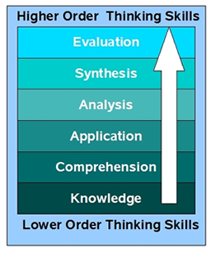
Education Perspective
Notes:
But in practice, the focus tends to fall on the cognitive domain
The upper 3 levels of Bloom's Taxonomy are often offered as an example of what constitutes critical thinking - ANALYSIS, SYNTHESIS, EVALUATION
Sometimes the next 2 levels are added: COMPREHENSION & APPLICATION
The problem is that Bloom's levels are not really hierarchical: - synthesis and evaluation generally require analysis, but analysis generally requires synthesis and evaluation
Plus these 5 concepts tend to be too vague to guide actual teaching
http://retechtraining.files.wordpress.com/2008/07/blooms-taxonomy.jpg
http://nli2011.wikispaces.com/Bloom's+taxonomy

Slide 13
Bloom’s Revised Taxonomy
http://www.nwlink.com/~donclark/hrd/bloom.html
Notes:
Lorin Anderson, a former student of Bloom, offered a refinement of Bloom’s taxonomy in the 90s, most notably changing from noun forms to verb forms
This is a depiction of the changes proposed by Anderson advanced by Michael Pohl:
Pohl, M. (2000). Learning to Think, Thinking to Learn: Models and Strategies to Develop a Classroom Culture of Thinking. Cheltenham, Vic.: Hawker Brownlow.

Slide 14
HOTS vs. LOTS
http://edorigami.wikispaces.com/Bloom's+Digital+Taxonomy
Notes:
This is another visual representation Anderson’s work with David Krathwold:
Anderson, L. W., & Krathwohl, D. (Eds.). (2001). A taxonomy for learning, teaching, and assessing: A revision of Bloom's taxonomy of educational objectives. New York: Longman.
Krathwohl, D. (2002). A revision of Bloom's taxonomy: An overview. Theory Into Practice, 41(4), 212-218. Retrieved from http://www.unco.edu/cetl/sir/stating_outcome/documents/Krathwohl.pdf
An interactive variation of the above is available at IOWA state:

Slide 15
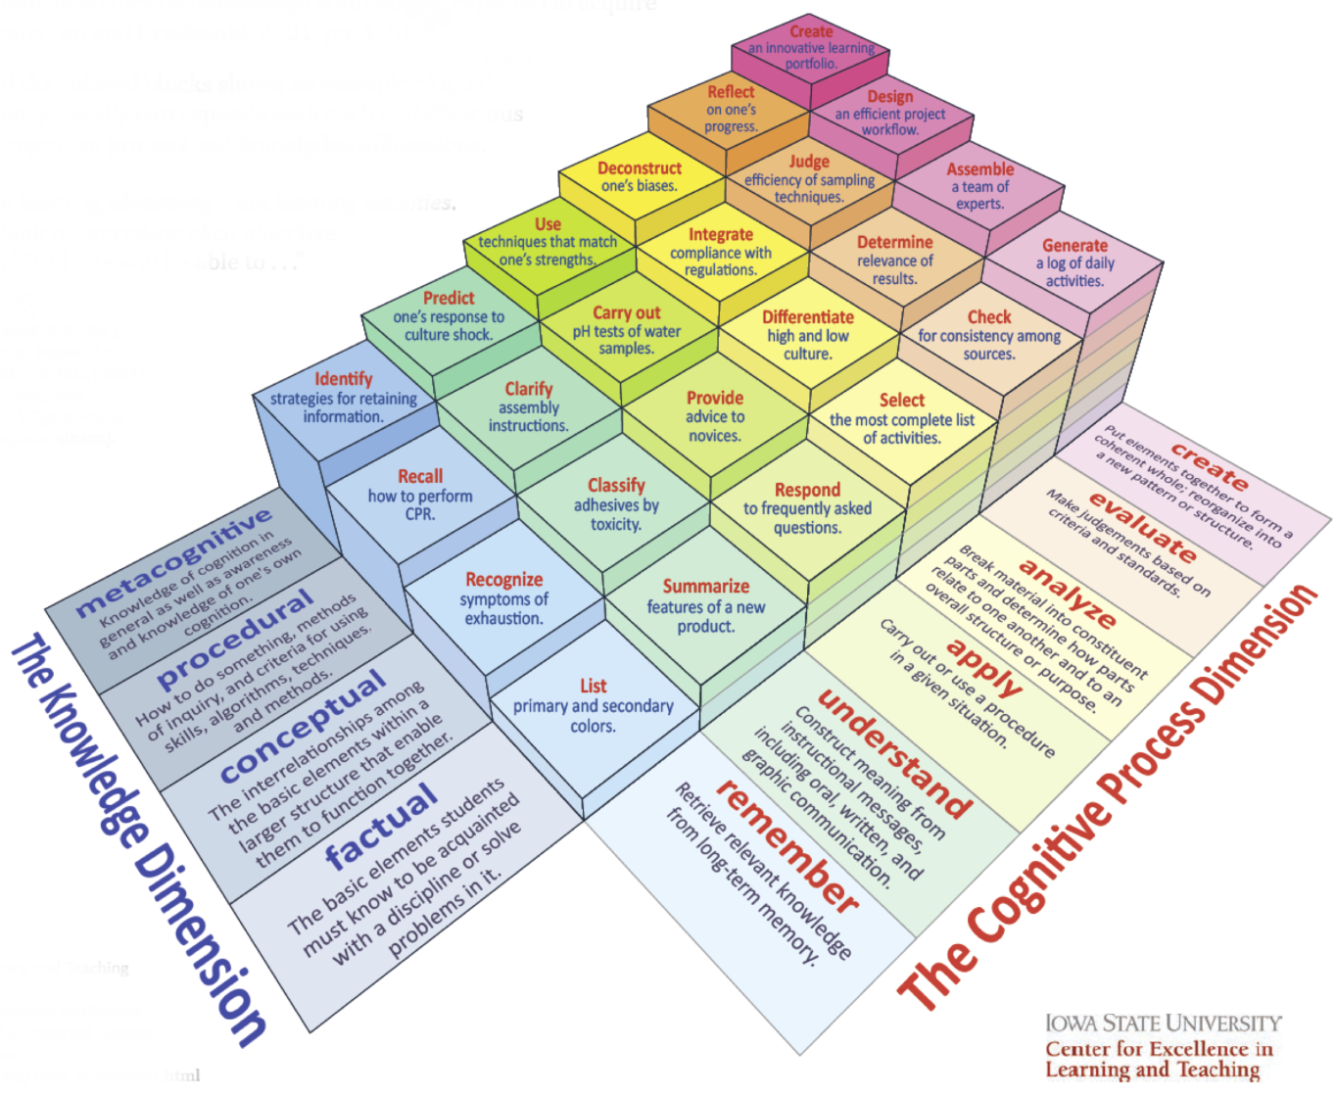
Iowa State Learning Objectives Resource
Iowa State Interactive Model of Learning Objectives
Notes:
http://www.celt.iastate.edu/teaching/RevisedBlooms1.html
A useful PDF of learning objectives can also be downloaded from the same page: http://www.celt.iastate.edu/pdfs-docs/teaching/RevisedBloomsHandout.pdf
But the cognitivist focus of Bloom’s approach remains a problem for a number of educators, who argue that critical thinking involves more than the ability to recognize logical fallacies, identify biases and uninformed judgments, and to be skilled at reasoning.
They see Bloom’s approach as depoliticized and dehistoricized
Joe Kincheloe (2000), for instance, defines critical thinking as “the ability of individuals to disengage themselves from the tacit assumption of discursive practices and power relations in order to exert more conscious control over their everyday lives.” (p. 24)
- Kincheloe, J. (2000) Making Critical Thinking Critical, in D. Weil and H.K. Anderson (eds.), Perspectives in Critical Thinking: Essays by Teachers in Theory and Practice, New York, Peter Lang
And Stephen Brookfield (2010) contends that critical thinking “is the educational implementation of ideology critique, the deliberate attempt to penetrate the ideological obfuscation that ensures that massive social inequity is acceptable by the majority as the natural state of affairs.”. (p. 58)
- Brookfield, S. (2010) Radicalizing Learning: Adult Education for a Just World, New York, Jossey Bass
But now let us turn to two approaches to critical thinking currently in use at AU:
The first, Information Literacy, is another generalist approach, but the second is a specialist approach with its roots in rhetoric

Slide 16
Information Literacy Perspective
Information literacy is the ability to:
Determine the extent of information needed
Access the needed information effectively and efficiently
Evaluate information and its sources critically
Incorporate selected information into one’s knowledge base
Use information effectively to accomplish a specific purpose
Understand the economic, legal and social issues surrounding the use of information, and access and use information ethically and legally
(Association of College & Research Libraries, 2000, 2-3)
Notes:
Elaine

Slide 17
Thinking Critically About the Research Process
Analysis
(planning)
Synthesis
(reflection)
Evaluation
(judgment)

Slide 18
Revise
Repeat
Rethink

Slide 19
Self-Reflection on the Research Process
How do you normally approach a research assignment?
What strategies work or don’t work?

Slide 20
Thinking Critically About the Research Process
Strategies for Understanding Assignments
Research Journal
Pose Questions
Taking Notes

Slide 21
Strategies for Understanding Assignments
What are the key concepts?
What is your topic really about?
Restate the research topic in your own words
Rephrase your topic as a question
What other words can be used to describe the concepts in your topic?

Slide 22
Sample Research Journal
 | Search Terms
 | Concept 1 | Concept 2 | Concept 3
 | Treating | Children | Autism
 | treatment | Child | Autistic
 | cure | youth
 | therapy | infants
 | rehabilitation | kids
 | Search Strategies
1 | treating and children and autism
2 | (Treatment or therapy) and (children or infants) and autism
3 | (treatment or cure or rehabilitation) and (child* or youth or kids) and (autism or autistic)
 | Databases Searched | Search Strategy Used | # of Results Retrieved | Comments
 | PsycARTICLES | 1 | 1674 | Large number of results, need to narrow search, results do not seem to be specific enough

Slide 23
Evaluating a Search
What do I consider a “successful search”?
Relevant results on my topic
Recent results
Appropriate number of peer reviewed sources
Results from experts in the field

Slide 24
Evaluating a Search
How many results were retrieved? Many? Few? What does that mean? (Good/bad search?)
What types of results were retrieved? Scholarly, peer reviewed, magazines?
How recent are the results?
Do any results appear (at first glance) to be relevant?

Slide 25
Evaluating Resources
Does the resource answer your question or help you to understand it better?
Does the resource support your point of view?
Does the resource cover the right time period?
Is the resource appropriate to your level?
Does the resource meet the publication date range specified in your assignment?
Is the resource scholarly or peer reviewed and does it match the requirements of your assignment?
Does the author of the item appear to be an authority on the topic?
Notes:
Just as with

Slide 26
Reading Critically
What problem or issue is the author addressing?
Is the problem or issue clearly identified?
How does the author make their argument (e.g. by appealing to emotion, objectively etc.)
Is their bias in the argument and what is it?
How is the argument laid out or structured?
What contributions does the item make to your specific information need?
How does this document relate to other literature you have read?
Notes:
Just as with

Slide 27
Taking Notes
Make note of the complete citation!
Identify where you found the item (e.g. name of specific journal database, AU Library Catalogue, Web, etc.)
Develop a strategy for identifying your own thoughts in your notes
If you are capturing important quotes, mark them as such and include the page number

Slide 28
Critical Thinking from an Academic Writing Perspective
A developmental and dynamic mental process, with parallels to the academic writing process, built on intellectual habits of mind,
characterized by acts of judgment, planning, deliberating, justifying, challenging and self-correcting,
and aimed at applying a set of criteria to solve a problem or answer a question.
(Paul & Elder, 2005; Toulmin in Golden, Berquist & Coleman, 1998; Van Gyn & Ford, 2006 )
(Paul & Elder, 2005; Toulmin in Golden, Berquist & Coleman, 1998; Van Gyn & Ford, 2006 )
Notes:
From a writing perspective, critical thinking informs academic writing and academic writing develops CT.. This definition highlights that. Here, some of the Intellectual habits of mind we’ve already heard about: include respect for truth and reason, willingness to examine personal assumptions, curiosity, fair-mindedness, strong work ethic, willingness to debate the status quo are essential to both thinking well and writing well. This definition, (and it’s just one) there is also a sense of acting on the judgments people have made, that the set of criteria is applied to a problem or a question, and this would be true of both good academic writing and critical thinking. This writing perspective would be more the generalist school that Derek talked about, drawing out general principles for critical thinking.

Slide 29
Critical Thinking from an Academic Writing Perspective
The act of challenging assumptions and coming to conclusions through systematic inquiry
(Paul & Elder, 2005; Toulmin in Golden, Berquist & Coleman, 1998; Van Gyn & Ford, 2006 )
Notes:
But for our purposes, we might want a more general definition of CT. And this definition might suit us because it implies the REASONS for cultivating those habits of mind, and applying a set of criteria. CT’s purpose is to analyze and synthesize new ideas by challenging assumptions, ours and others through some system of inquiry. This system can vary from discipline to discipline because disciplines operate on different assumptions. For instance, biology assumes principles of evolution and biological processes and psychology assumes the presence of a thing called a “psyche”. Each discipline has assumptions that determine how knowledge is judged as legitimate . The connection between this definition of Critical Thinking and academic writing is the idea of systematic inquiry.

Slide 30
The Critical Thinking/Academic Writing Connection
Stephen Toulmin’s rhetorical model: one way to a clear thesis
(Golden, Berquist &Coleman, 1989)
Data
Warrant
Claim
Since
Evidence
Conclusion
Notes:
Academic writing has had a long historical connection with critical thinking, And that makes sense because developing an academic piece of writing is in part the act of challenging assumptions-your own and others’ on paper. The system for thinking and writing critically that I’m going to show you is one that should help you to think through writing assignments and critically think about sources you are reading. A few words of caution first though: although this will apply to many topics and subjects you will address in humanities, it will not apply to all situations. For example, if you are writing a report, this approach to critically thinking will probably not help you as much as say, if you are doing an analysis/assessment of a theory in the humanities. But it is a way of developing a clear thesis for your paper.
Stephen Toulmin is an example a modern systematic way coming to judgment based on designated criteria and a way of uncovering and questioning assumptions. Toulmin’s way of thinking through an issue is to gather data and reason through to a conclusion.
The three main parts of his argument are
Data, Warrant, Claim. Let’s start with the data. This is the evidence that you gather as you read your sources until you ultimately reach the conclusion, or the claim. In other words, as you think through your problem or question, you look for data to support a conclusion that you’re coming to. The Warrant is the assumption that provides a logical link between the data and the conclusion. In other words, the Warrant is the reason that the data supports the claim. Let’s see how this looks in an example.

Slide 31
The Critical Thinking/Academic Writing Connection
Stephen Toulmin’s Model of Argument
Data
Warrant
Claim
Evidence: more people have rated him positively on “Rate my Doctor”
Since: “Rate my Doctor” is a good measure of a doctor’s skills
Conclusion: Therefore, Doctor A is better than Doctor B
Notes:
Suppose after doing research on Doctor A and Doctor B, I want make a claim that Doctor A is a better Doctor than Doctor B. That’s my claim. What’s my evidence? Well, suppose that the research I did was on a website called “Rate my Doctor”, and there, more people have rated Doctor A more highly. Some people might leave it at that. But critical thinkers would ask “what is the quality of the evidence?” The assumption underneath the evidence—the Warrant—is that the site “Rate my Doctor” is a good measure of a doctor’s skills. Notice how this simple but systematic way of thinking makes assumptions more obvious, and it’s often the assumptions that are most vulnerable to argument—an argument is only as good as its weakest Warrant.
By the way, does any one have any problems with this Warrant.

Slide 32
The Critical Thinking/Academic Writing Connection
Unless
Probably
(Golden, Berquist &Coleman, 1989)
Data
Rebuttal
Qualifier
Claim
Warrant
Backing
Because
Notes:
So, there are three more elements that you can use to deal with situations like this. If your warrant is not all that strong, you can add a qualifier, which is about how strong an argument is. It identifies the limitations of your conclusion and you can get at qualifiers by asking questions like “when, where, under what circumstances” is your claim true. You can think of qualifiers as a statement that begins with “probably”.
A rebuttal also qualifies your claim by identifying specific limitations or circumstances that might limit your claim. These are different from qualifiers in that they’re more specific. You can think of rubuttal as an “unless” statement. MY claim is true UNLESS this condition exists.
Finally, you can strengthen a weak warrant with a “because” statement that gives additional reasons why your warrant provides a good connection between the data and the claim. Thinking systematically like this can make any weaknesses in your own thinking apparent. This might mean going back to the literature or changing your thesis altogether.
So let’s see how this might play out in

Slide 33
The Critical Thinking/Academic Writing Connection
Unless some patients were not fair in their comments
Probably
Rebuttal
Warrant
Qualifier
Claim
Data
Evidence: More people have rated him positively on “Rate my Doctor”
Since “Rate my Doctor” is a good measure of a doctor’s skills
Therefore, Doctor A is better than Doctor B
Backing
Because research shows that sites like “Rate my Doctor” are reliable sources of information on a doctor’s medical and interpersonal skills
Notes:
So here is what the entire argument/reasoning might look like . I’m still claiming that Doctor A is a better doctor than Doctor B based on the ratings of “Rate my Doctor” , but now I’m going to strengthen my argument by saying that this is probably the case, and allowing that some patients might not have been fair in their comments, and by adding some backing to my argument by referencing research.
Again, this system lays out the support for the argument so you can examine it,
and I don’t know about you, but if I heard that there was research backing this up, I’d tend to want to know about the quality of the research that said that “Rate my doctor” was a reliable source of information. Skepticism is one of those habits of mind of critical thinkers that we talked about.

Slide 34
The Critical Thinking/Academic Writing Connection
Dr. A is probably a better physician than Dr. B because he was rated more highly on “Rate my Doctor” (unless some patients were not fair in their remarks about Dr. B) since “Rate my Doctor is a good source of information about a doctor’s skills because research shows that sites like “Rate my Doctor” provide a reliable reflection of a doctor’s medical and interpersonal skills.
Notes:
So here is what that argument would look like written out.
And this has all the qualities of a good thesis. In fact, this could be a thesis statement that you could work out a defense for and use as an outline for a paper.
For example:
You might begin with an introduction that presents this thesis
Then, you might have a couple of paragraphs that present your own reasons for saying that “Rate my Doctor” is a good source of information: maybe the info is uncensored, people’s direct experience, etc.
Then you might follow with a paragraph about the research that shows that sites like these provide a reliable reflection of physician skills. If you came across research that disputed this, you might present this and say why the research in favor of such sites is more believable, superior, etc.
The point I want to make here is that such systematic thinking and reasoning leads to a clear thesis and an organized paper. And keep in mind that this is the organization that happens AFTER you have done the research.

Slide 35
Critical Thinking and Academic Writing Processes
Planning/Prewriting
Deliberating/Outlining
Justifying/First Draft
Challenging/Second Draft
Self –Correcting/Final Draft
Asking good questions/Pre-reading
Identifying biases/underlying assumptions/Identifying key questions
Identifying problems/issues/questions/
Drawing original conclusions/
Offering good evidence/ Refining the thesis
Testing reasons
Testing conclusions/ Organizing the text
Outlining and organizing the text
Critically evaluating sources
Selecting criteria for evaluation
Asking good questions of the material
Reflecting on the quality of CT
Refining the thesis
Assessing the argument
Revising for content/arrangement
Tightening the logic/flow
Editing for grammar/meaning
Formulating a thesis
Analyzing and synthesizing ideas
Adapted from “Critical Thinking Competency Standards: Standards, Principles, Performance Indicators, and Outcomes with a Critical Thinking Master Rubric” by R. Paul and L. Elder, p. 20-55. Copyright 2005 by Foundation for Critical Thinking.
Notes:
But this doesn’t happen in one draft, and if you take away only one thing about critical thinking and academic writing from this presentation, it’s this: There is no such thing as good writing. There is only good rewriting.
And, as you can see here, this is true of both the writing process and critical thinking.
Here, you see a diagram of the writing process (in red) side by side with the critical thinking process (in white), as outlined by Paul and Elder. (This reference is in the bibliography for this presentation, so you check it out if you want to learn more about the critical thinking process.)
Note first that all activities here are recursive, that is, you go round and round again in a process that refines both your ideas and your writing. For example, in the prewriting phase, where you are first reading your sources, and identifying key questions, you are also engaging in Critical Thinking activities like identifying underlying assumptions, like we just saw, and identifying problems, issues and questions.
And, in the Final Draft stage, when you’re refining the thesis, and editing for grammar, mechanics, you are also assessing the quality of the argument, tightening the logic/flow
Both processes here are conceived as iterative ones, not linear. In other words, we could easily have arrows going across the circle and back in addition to the circular arrow.

Slide 36
The Critical Thinking/Academic Writing Connection
“Although we can think without expressing our ideas, we cannot write well without thinking…[Thinking] provide[s] the substance of composition” (Ruggierio,1998, p.233).
Characteristics of substantive composition:
Unity
Coherence
Emphasis
Development
Notes:
Another connection between critical thinking and academic writing is in writing substantively
This scholar, Ruggeirio, who has done considerable writing on critical thinking proposes that, again, good thinking is behind substantive academic writing. Writing is substantive when it makes connections between the conclusion that you have thought through and the parts of your argument
And the way to do that is provide unity, coherence, emphasis and development to your paragraphs and arrangement.
Ruggierio (1998) in The art of thinking: A guide to critical and creative thought (5th ed.) proposes, “Although we can think without expressing our ideas, we cannot write well without thinking…[Thinking] provide[s] the substance of composition” (p.233).

Slide 37
Substantive writing through paragraphing
Adapted from “How to Write a Paragraph: The Art of Substantive Writing” by R. Paul and L. Elder. Copyright 2003 by Foundation for Critical Thinking
Topic (sentence)
Supporting evidence, ideas
Point about the thesis
Notes:
One way to achieve substantive writing is to make sure that your paragraphing is coherent, unified, fully developed and emphasizes an idea about the thesis. Another way of saying this is that the point of each paragraph should move you closer to the conclusion.
So we can think of the structure of a paragraph as being surrounded by the topic sentence, which carries the main idea that the paragraph will develop, which leads inward to the supporting ideas and the evidence, which points to the main point that you want to make to advance the thesis.
Let’s see how this works in an example.

Slide 38
Example of a substantive paragraph
Although these sites may give some indication of a doctor’s interpersonal skills, research indicates that they do not supply reliable information about a doctor’s medical skills and may actively harm existing doctor-patient relationships.
Not only are the comments on sites like “Rate my Doctor” questionable, some research shows that they could damage the doctor-patient relationship. For example, Smith (2011) , in a survey of 300 Canadian physicians concluded…In addition, Brown (2012) demonstrated… This research suggests that if a patient has an existing, good relationship with a doctor, sites like “Rate my Doctor” can lead to mistrust of the physician and noncompliance with treatments.
Notes:
For example, if instead of trying to assess whether one doctor was better than another, as in my previous example, I was trying assess the general usefulness of these kinds of sites, like “Rate my Doctor” and
my conclusion after reading, and thinking critically about the question was that such sites “do not supply reliable information about a doctor’s medical skills and may actively harm existing doctor-patient relationships, although they may give some indication of a doctor’s interpersonal skills.”
I MIGHT HAVE A THESIS STATEMENT THAT LOOKS LIKE THIS.
I might have a paragraph like this in my writing.
The first sentence IN RED introduces a topic that directly links back to the thesis. Notice that the sentence mentions “Rate my Doctor” and introduces the point I’m going to make.
Next, in the BLUE text, I cite some research that supports my point. Remember that part of my backing in the thesis was that research supported my conclusion. Here, I’m creating coherence in both the paragraph and the paper by developing that idea. I MIGHT HAVE A FEW MORE SOURCES THAT SUPPORT THIS NOTION AND…
Finally, I explicitly make the point that the research supports my thesis that sites like “Rate my Doctor” can cause damage through mistrust and non-compliance. This last point creates coherence and unity by telling the reader that the point of the paragraph is clearly in support of one of the main ideas in the thesis/ conclusion.

Slide 39
Outlining
Conclusion/Thesis: Sites such as “Rate My Doctor” do not supply reliable information about a doctor’s medical skills and may actively harm existing doctor-patient relationships, although they may give some indication of a doctor’s interpersonal skills.”
Intro
Section 1-Why these sites do not supply reliable information
PARA 1a-They are not reliable because of commentators’ lack of medical knowledge
PARA 1b- They are not reliable because…
Section 2-How they actively harm existing doctor-patient relationships
PARA 2a- SAMPLE PARAGRAPH
PARA 2b- These sites can lead to non-compliance with treatment…
Section 3-Why and how the sites give indication of doctors’ interpersonal skills
PARA 3a-Why
PARA 3b-How
Conclusion
Notes:
Most of you will be writing long documents, and in this case, you can create coherence by breaking the document down into sections and linking the paragraphs to each section which, in turn, links to the conclusion. This is where outlining comes in in creating a roadmap that leads to your conclusion.
If I had a thesis like the one I mentioned for the paragraph we just looked at, here’s how I might develop an outline linking the paragraph to each sections. Notice that that sample paragraph is clearly tied to the topic of the section—that these sites can harm existing doctor-patient relationships and that supports the conclusion.

Slide 40
Principles for learning CT through writing
CT feeds well structured, developed, logical writing and vice versa.
Sharpening the focus and organization of a piece of writing helps to sharpen critical thinking on a topic.
“Writing to think” and “thinking to write” i.e., focusing on paper’s thesis/conclusion, development, organization and the quality of the argument are mutually supportive skills.
The development of thinking is evident in the drafting process of a piece of writing.
Writing is a way of engaging in critical dialogue with oneself and one’s audience.
Notes:
With such a strong connection between the development of academic writing and critical thinking skills, there are some principles that we can draw from this about the learning relationship between the two: it’s a reciprocal relationship

Slide 41
Checks for demonstrating CT through writing
Have you used your drafting process to think through to your conclusion systematically, using a system and set of criteria that are appropriate to the discipline and the assignment or writing occasion?
Have you done multiple drafts, keeping in mind that remember there is no good writing, only rewriting?
Have you planned enough time for your thinking, reflection, and drafting?
Have you maintained coherence, unity, development and proper emphasis in your paragraphs and in your sections?
Have you used an outline (or some kind of prewriting) to check the connections between the sections and your conclusion?
Do your paragraphs and sections lead your readers closer and closer to your conclusions?
Notes:
This connection also suggests some things to check for to see if you have demonstrated critical thinking in your writing.

Slide 42
Tips for visual organization of your work
Use of visual analytical tools to express your ideas:
Concept maps
Charts
Thematic matrices
Tables
Figures
Etc.
Notes:
Corinne
Use of visualization tools to brainstorm, develop & articulate concepts/conceptual framework

Slide 43
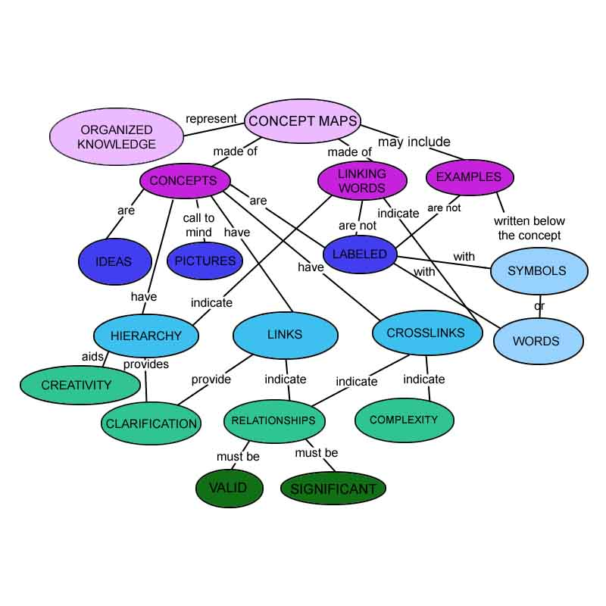
Notes:
Concept map: diagram showing the relationships among concepts;graphical tool for organizing and representing knowledge
Source: http://cfcc.edu/dutch/IntroGraphic.html

Slide 44
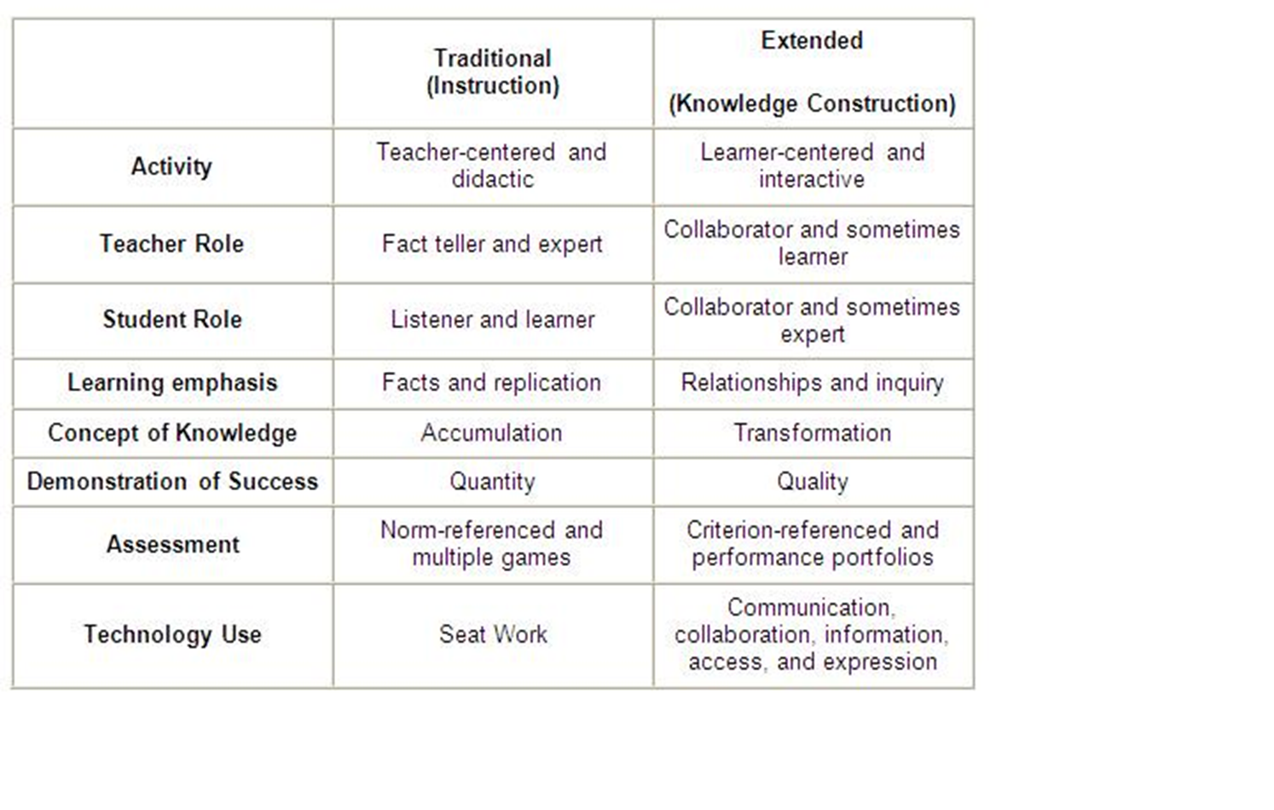
Stages of Teacher Development
Notes:
Source: http://teacherpro.wordpress.com/

Slide 45
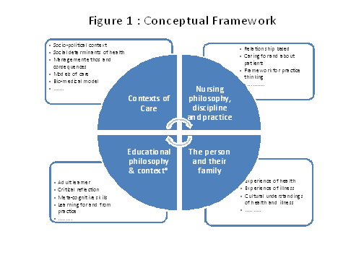
Notes:
Source: Sydney U Nursing School/curriculum:
http://sydney.edu.au/nursing/learning_teaching/conceptual_framework.shtml

Slide 46
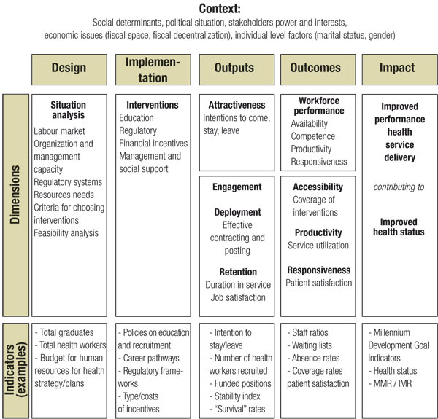
Notes:
Source: Increasing access to health workers in underserved areas: a conceptual framework for measuring results, WHO
http://www.who.int/bulletin/volumes/88/5/09-070920/en/index.html

Slide 47
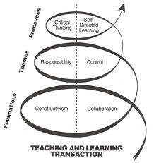
Notes:
Source: Conceptual Framework of the Transactional Perspective (Garrison & Archer, 2000)
http://www.flickr.com/photos/jrhode/2103949231/

Slide 48
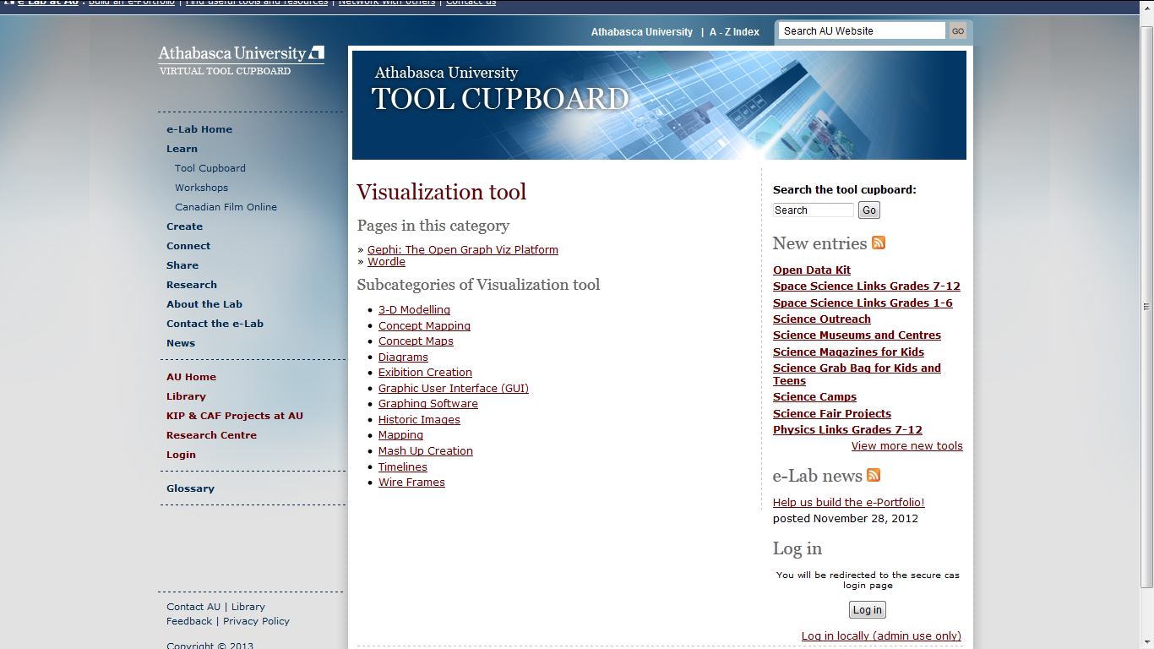
Notes:
e-lab visualization tools
http://tools.elab.athabascau.ca/category/tool-entry/visualization-tool

Slide 49
Interactive Infographics

Slide 50
Discussion: Graduate Critical Thinking Activities
Reflective Analysis
Word Limit: 1,250 maximum (6 double–spaced typed pages)
Choose from the assigned (cultural history) readings what you consider to be a pivotal, transitional period/event/personage.
Then discuss your chosen subject in three parts consisting of a description, an analysis, and a reflection.
Notes:
Derek leads the discussion with his guidelines for critically approaching a graduate assignments in MAIS courses

Slide 51
Reflective Analysis
Description (15–25% of the exercise):
Start out by briefly describing
a. the social relations (how society was structured)
b. the political relations (who held or shared power and how that power was legitimated)
c. the cultural relations (the Zeitgeist or cultural/intellectual mood of the time) prior to and after the transition/event
Notes:
Derek leads the discussion with his guidelines for critically approaching a graduate assignments in MAIS courses

Slide 52
Reflective Analysis
Analysis (50–60% of the exercise):
Decide which of the three areas of relations (social, political, cultural) was responsible for the change(s) that triggered the transition and provide an analysis (a rationale and textual evidence) in support of your position. In your analysis, consider the question of whether this transition was an inevitable stage in the development of Western civilization, or the result of one or a series of contingencies that only appear inevitable in retrospect.
Notes:
Derek

Slide 53
Reflective Analysis
Reflection (10–15% of the exercise):
Conclude your analysis with a reflection on why you feel it is advantageous to consider questions such as this from an interdisciplinary perspective.
Please pay particular attention to the proportion of the exercise’s three elements:
Descriptive (15-25%)
Analytical (50-60%)
Reflective (10-15%)
Do not submit papers that are purely or primarily descriptive as a Reflective Analysis.
Notes:
Derek

Slide 54
Reaction Papers
(in response to an assigned reading)
Word Limit: 250–500, unless otherwise specified by the course professor
In developing your Reaction Papers, you might choose one or more of the following strategies:
Notes:
Derek

Slide 55
Reaction Paper
Challenge the construction of the argument, the definitions or concepts, the evidence supplied, the presence of logical fallacies, or the theoretical framework.
Relate the material discussed in the reading to other courses or other contexts.
Relate the material discussed in the reading to your own life experiences.
Identify something in the reading that you were surprised to learn, or found interesting or unexpected, and recount why.
Identify controversial, contentious, or debatable points, and offer credible counter arguments.
Notes:
Derek :
Assignment final instructions:
Conclude your Reaction Paper with two discussion questions that you will post online in order to initiate discussion in the online conference that you will be moderating. These questions should provoke others to think about, and respond to, the reading.
Please Note: Your Reaction Paper must move beyond a summary of the assigned reading or a simple like/dislike reaction.

Slide 56
Reflections: Critical Thinking Tips

Slide 57
THANK YOU!

Slide 58
Evaluation
What did you learn today?
What did you like about the workshop?
What recommendations do you have for next time?
What other concerns do you have about teaching and learning at AU that we could address in a workshop?

Slide 59
References: Writing Perspective
Brookfield, S. (2012). Teaching for critical thinking: Tools and techniques to help students question their assumptions [Kindle book]. San Francisco, CA: Jossey-Bass .
Bean, J. (2011). Engaging ideas: The professor’s guide to integrating writing, critical thinking, and active learning in the classroom. San Francisco, CA: Jossey-Bass.
Kneupper, C. W. (1978). Teaching argument: An introduction to the Toulmin Model. College Composition and Communication, 29(3), 237–241. doi:10.2307/356935
Paul, R. & Elder, L. (2003). How to write a paragraph: The art of substantive writing. Dillon Beach, CA: The Foundation for Critical Thinking.
Paul, R. & Elder, L. (2005). Critical thinking competency standards: Standards, principles, performance indicators, and outcomes with a critical thinking master rubric. Dillon Beach, CA: The Foundation for Critical Thinking.
Golden, J., Berquist, G., & Coleman, W. (1989). The rhetoric of western thought (4th ed.). Dubuque, IA: Kendall/Hunt Publishing Company.
Van Gyn, G. & Ford, C. (2006). Teaching for critical thinking. London, ON: Society for Teaching and Learning in Higher Education.
Ruggerio, V. R. (1998). The art of thinking: A guide to critical and creative thought (5th ed.). Reading, MA: Longman.

Slide 60
References: Information Literacy
Association of College & Research Libraries (2000). Information Literacy Competency Standards for Higher Education. Retrieved from: http://www.ala.org/acrl/sites/ala.org.acrl/files/content/standards/standards.pdf
Athabasca University Library. (2012). Writing a Literature Review. Retrieved from: http://library.athabascau.ca/help/LitReviewGuide.php
Bean, J.C. (1996). Engaging ideas: The professor’s guide to integrating writing, critical thinking, and active learning in the classroom. San Francisco: Jossey-Bass.
Grassian, E.S. (2009). Information literacy instruction: Theory and practice (2nd ed.). Chicago: Neal-Schuman.
Halpern, D. F. (1999). Teaching for critical thinking: Helping college students develop the skills and dispositions of a critical thinker. New Directions for Teaching and Learning, 80, 69-74.
Kop, R. (2012). The unexpected connection: Serendipity and human mediation in networked learning. Educational Technology & Society, 15(2), 2-11.
Ruggiero, V. R. (2009). Becoming a critical thinker (6th ed.). Boston: Houghton Mifflin.
Notes:
Additional references/resources to suggest to workshop participants

Slide 61
Useful Research Tutorials
Searching the AU Library Catalogue: http://aupac.lib.athabascau.ca/screens/help_index.html
Finding Journal Articles in the Library’s Collection (AKA AU Journal Title List Tutorial) : http://library.athabascau.ca/help/jportal/ejportal_viewlet_swf.html
AU Library Guide to the Research Process: http://libguides.athabascau.ca/researchprocess
Internet Searching: http://libguides.athabascau.ca/internetsearching
Searching Google Scholar for AU Library Resources: http://library.athabascau.ca/help/tutorials/googlescholar/googlescholar.html
Tips for Searching: http://libguides.athabascau.ca/booleansearching
Writing a Literature Review: http://library.athabascau.ca/help/LitReviewGuide.php

Slide 62
Useful Resources: Visualization tools
AU e-lab:
http://tools.elab.athabascau.ca/category/tool-entry/visualization-tool
Educational Inquiry Concept map:
http://eddcna.files.wordpress.com/2010/05/bubblus_educational_inquiry.png
Interactive Infographics:
http://infogr.am/
Novak, J. D. & A. J. Cañas, The Theory Underlying Concept Maps and How to Construct Them, Technical Report IHMC CmapTools 2006-01 Rev 01-2008, Florida Institute for Human and Machine Cognition, 2008", available at: http://cmap.ihmc.us/Publications/ResearchPapers/TheoryUnderlyingConceptMaps.pdf

